Slide 1




AWS – Amazon Quantum Ledger Database (QLDB) – Hands-on guide/ Case Study/ Use Case.
Mr. Subramanyam Tirumani Vemala
subramanyam.vemala@capgemini.com

Slide 2
QLDB Features:
Immutable and Transparent: Append-only journal and Easy access to change history.
Cryptographically Verifiable: Allows to verify the the changes, through the History called as Digest.
Serverless: Easy to Scale, Easy setup and Easy Monitoring and metrics.
Easy to Use: Uses, PartiQL as SQL for querying. Which is a Document-oriented data model with the Transactional Consistency and ACID Semantics.
Streaming Capability:

Slide 3
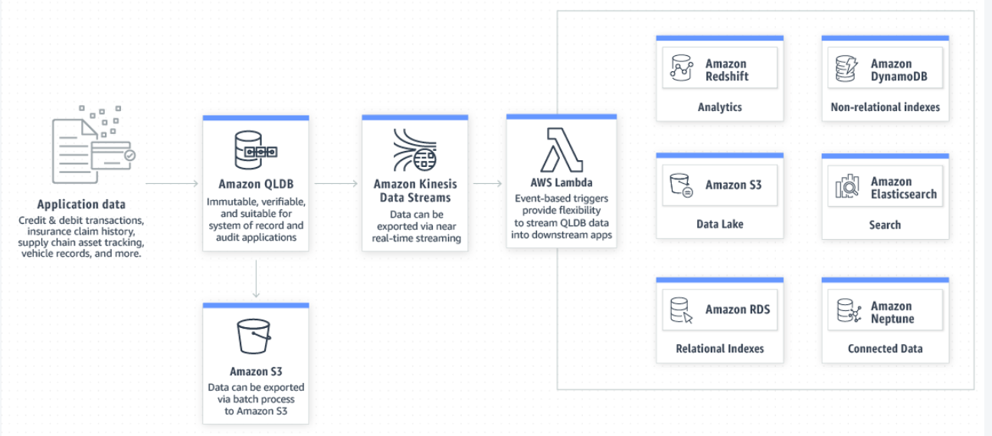
QLDB Architecture: Streaming Capability.

Slide 4
Details of the Case Study:
An Insurance company.
Schema with three tables (Customers, Policies and Claims), indexes and with sample data.
Claims table will be having multiple Claims. Chosen Claim904, for our case study. Necessary update statements will be ran on the Claim904 of the samples to create the History.
Scripts are available in my GitHub branch, https://github.com/subbugh/aws-qldb

Slide 5
Steps, Hands-on activity:
Create a Ledger.
Create Tables.
Create Indexes on the tables.
Insert Sample data.
Query the tables on the ledger.
Modify the data on the Ledger.
Download a couple of Digest’s after set of Modify transactions.
Verify the blockAddress’s of the transactions of a document in the Ledger.

Slide 6
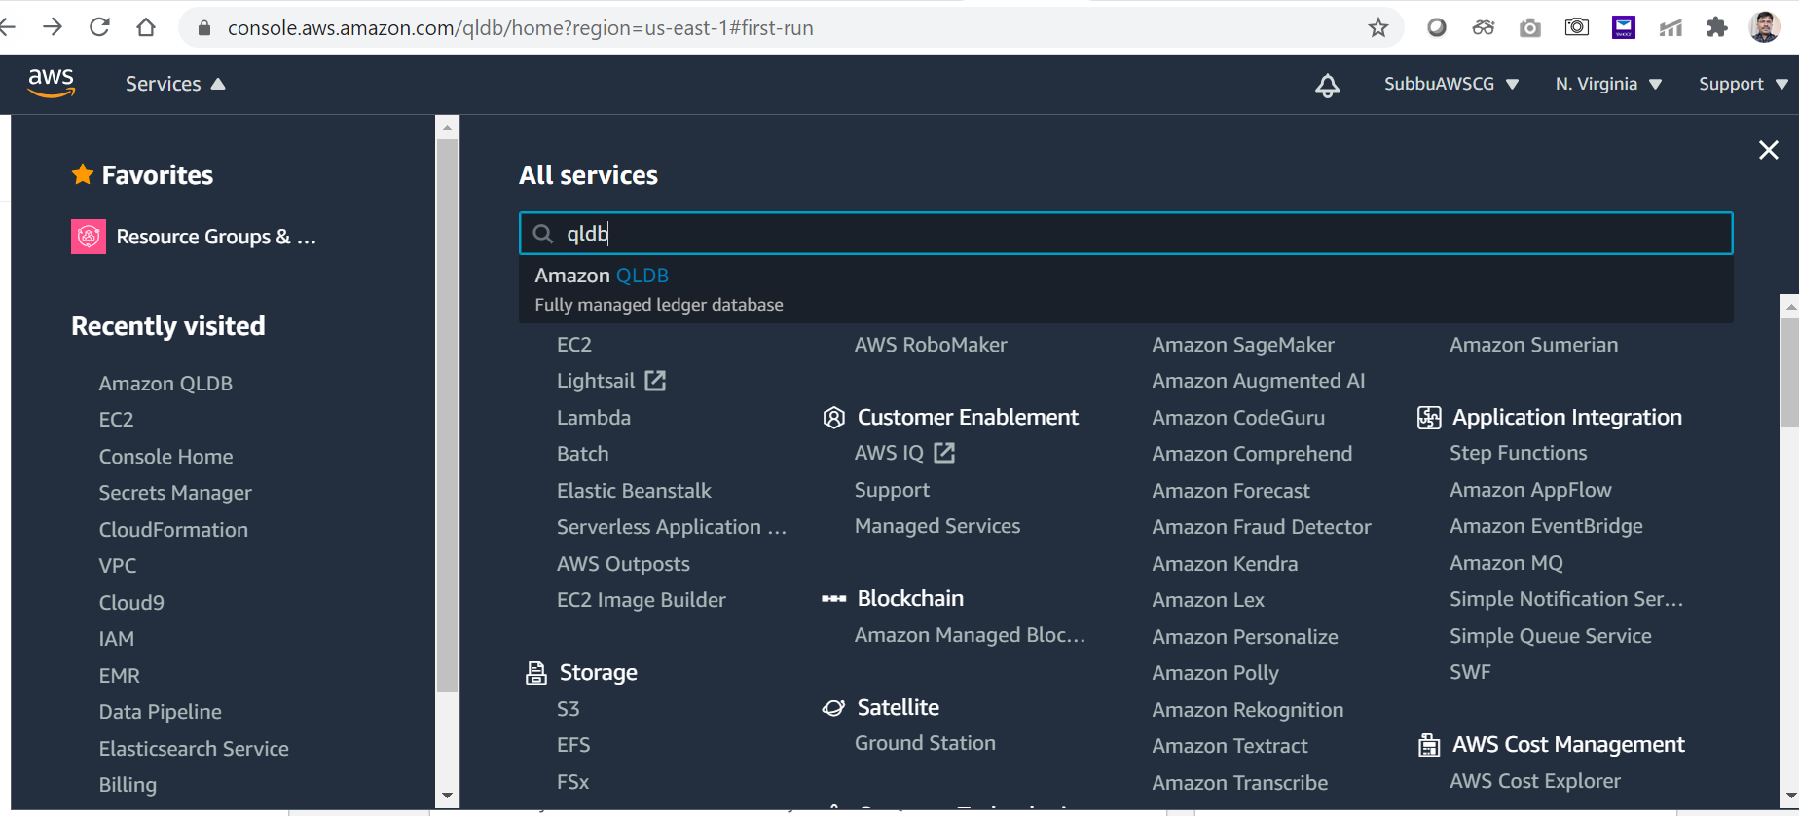
Step-1: Go to QLDB AWS services:

Slide 7
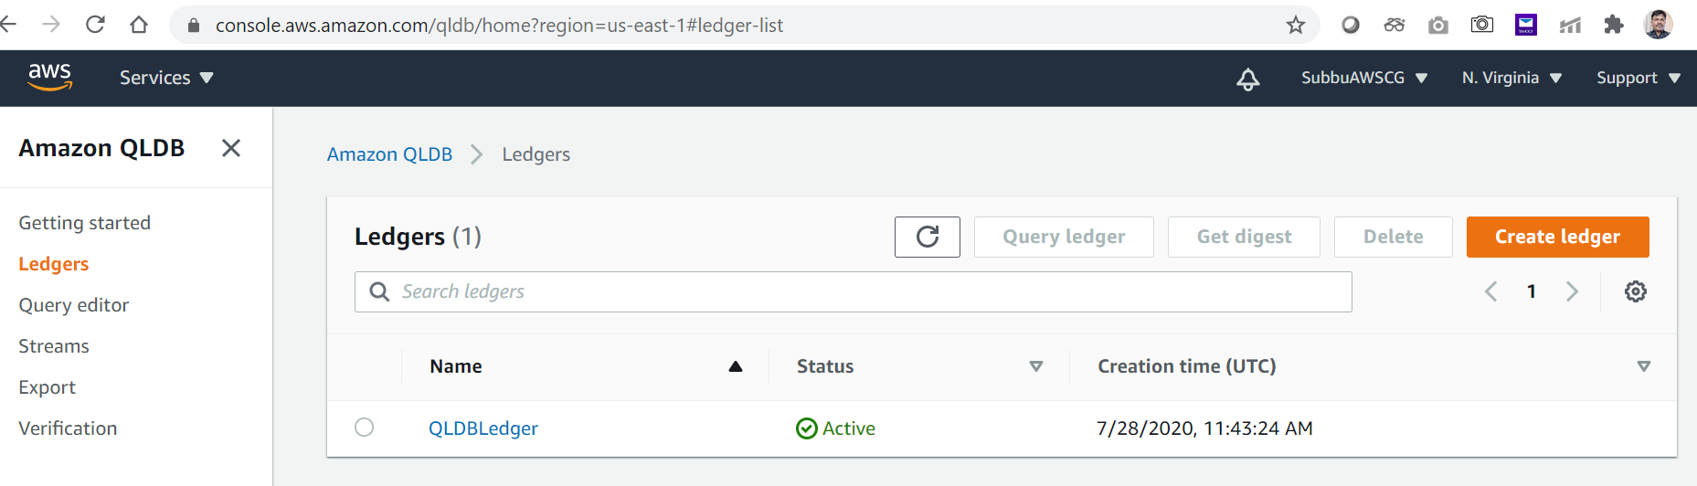
Create Ledger:

Slide 8
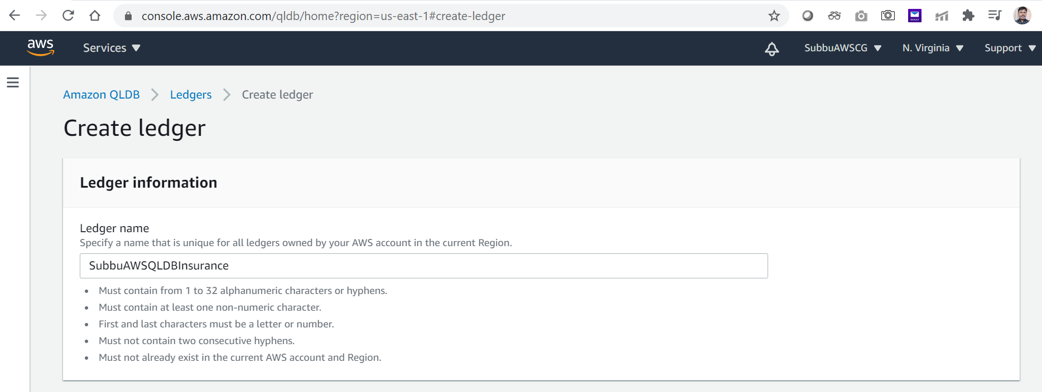
Fill in the details:

Slide 9
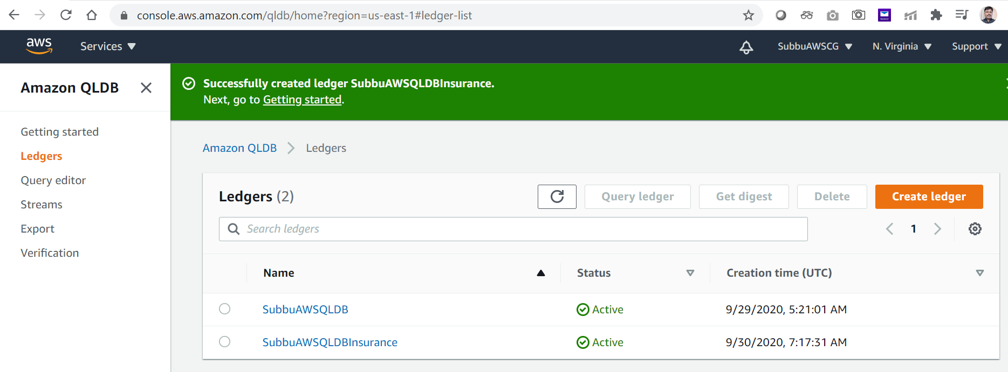
Ledger created:

Slide 10
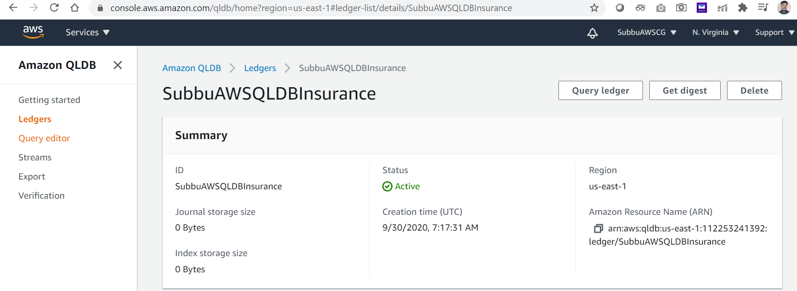
View of the Created Ledger:

Slide 11
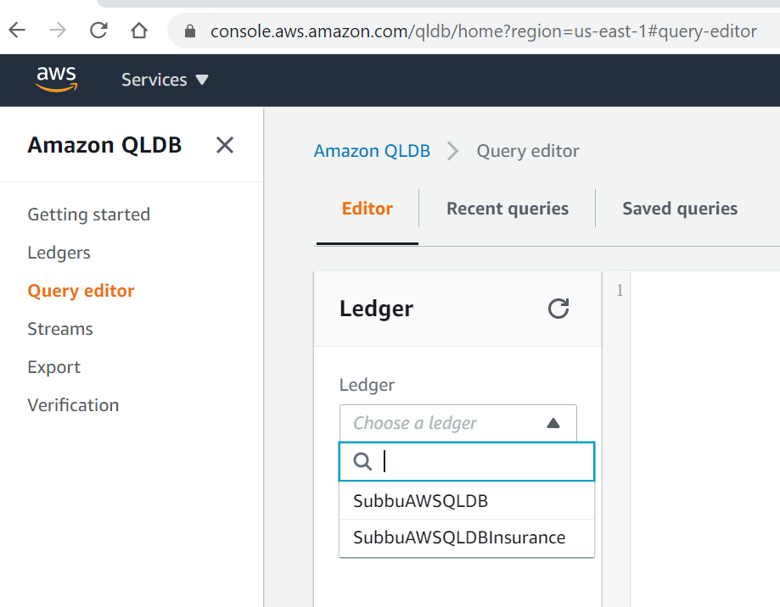
Step-2: Go to Query Editor – choose the Ledger:

Slide 12
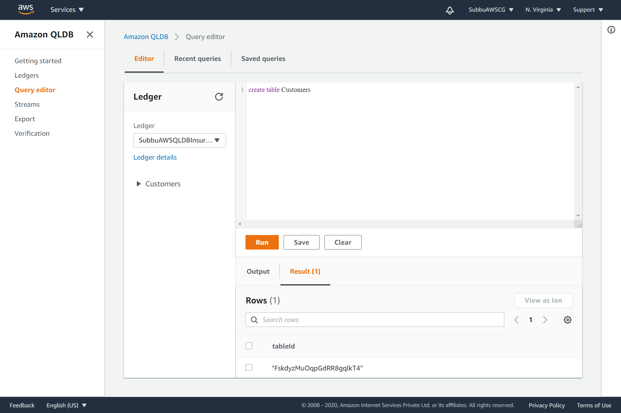
Query executed, Customers table is created:

Slide 13
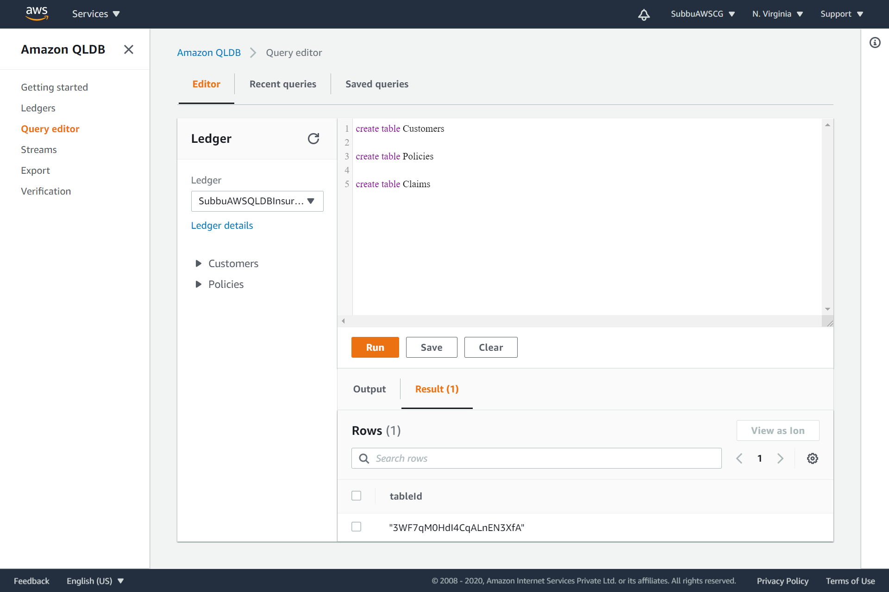
Query executed, Policies table is created:

Slide 14
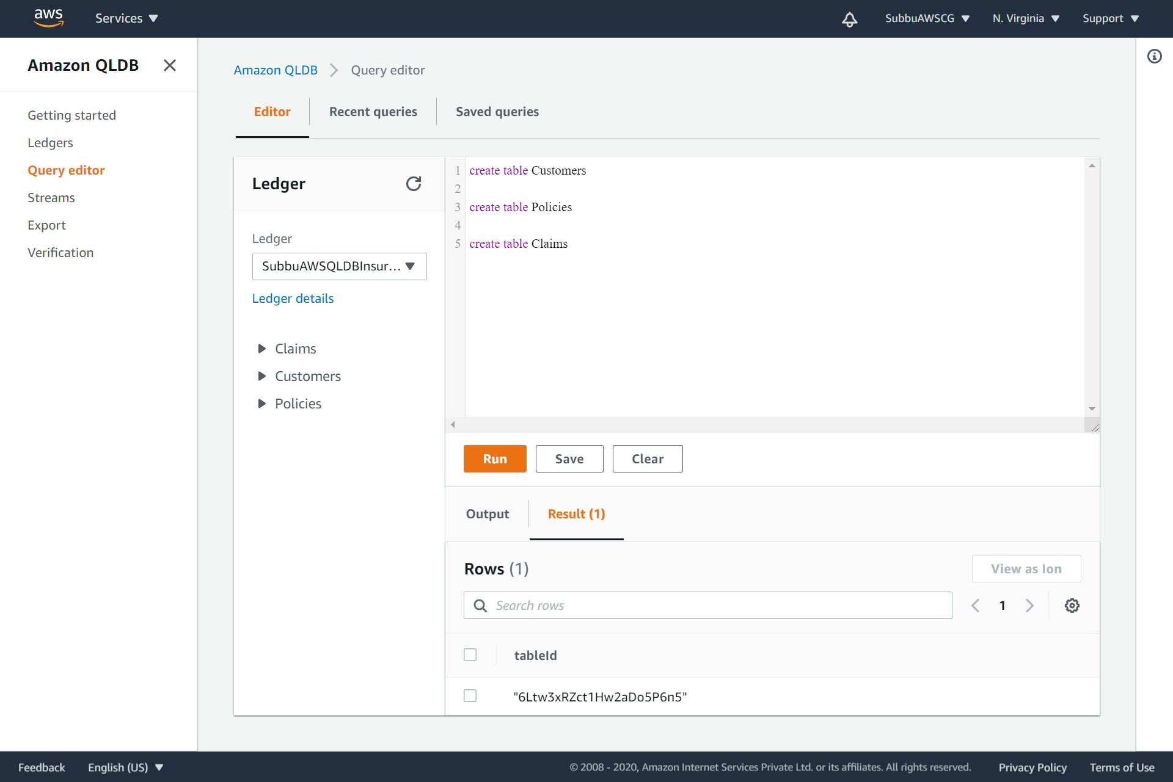
Query executed, Claims table is created:

Slide 15
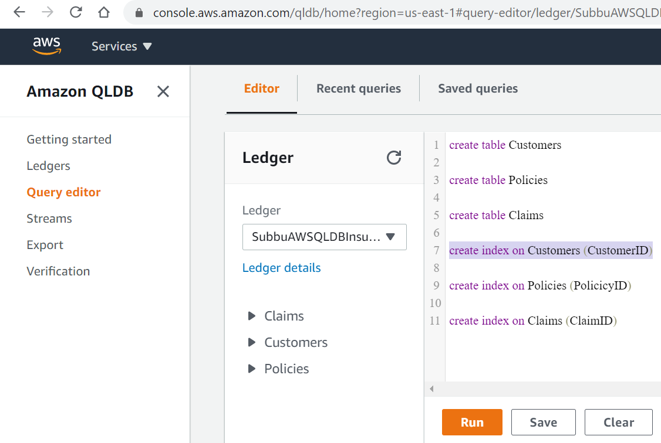
Step-3: Create Indexes on all the tables:

Slide 16
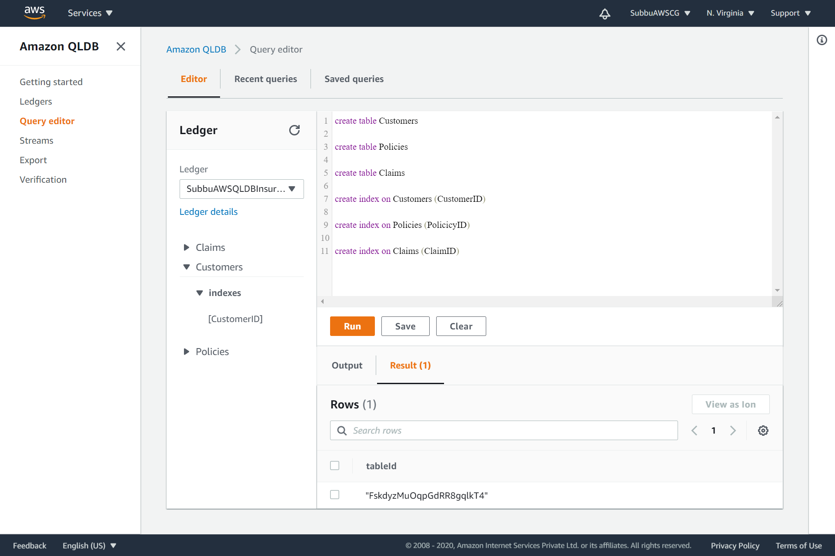
Create Index on the Customers table:

Slide 17
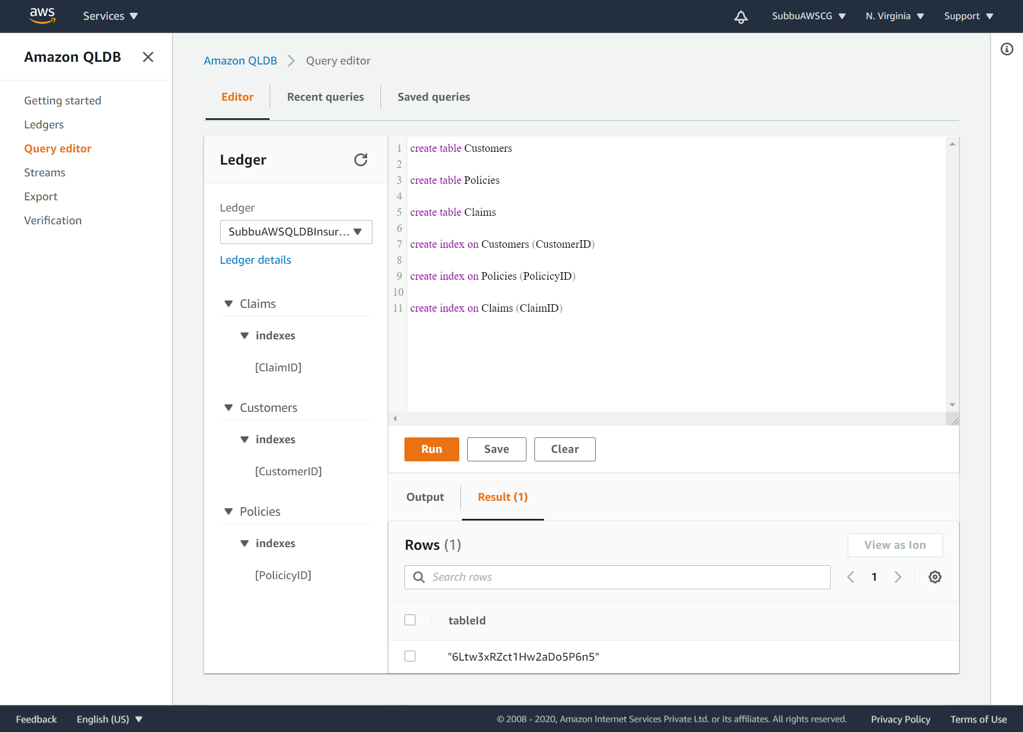
Create Index on the Policies table as below: Similarly create the index on the Claims table.

Slide 18
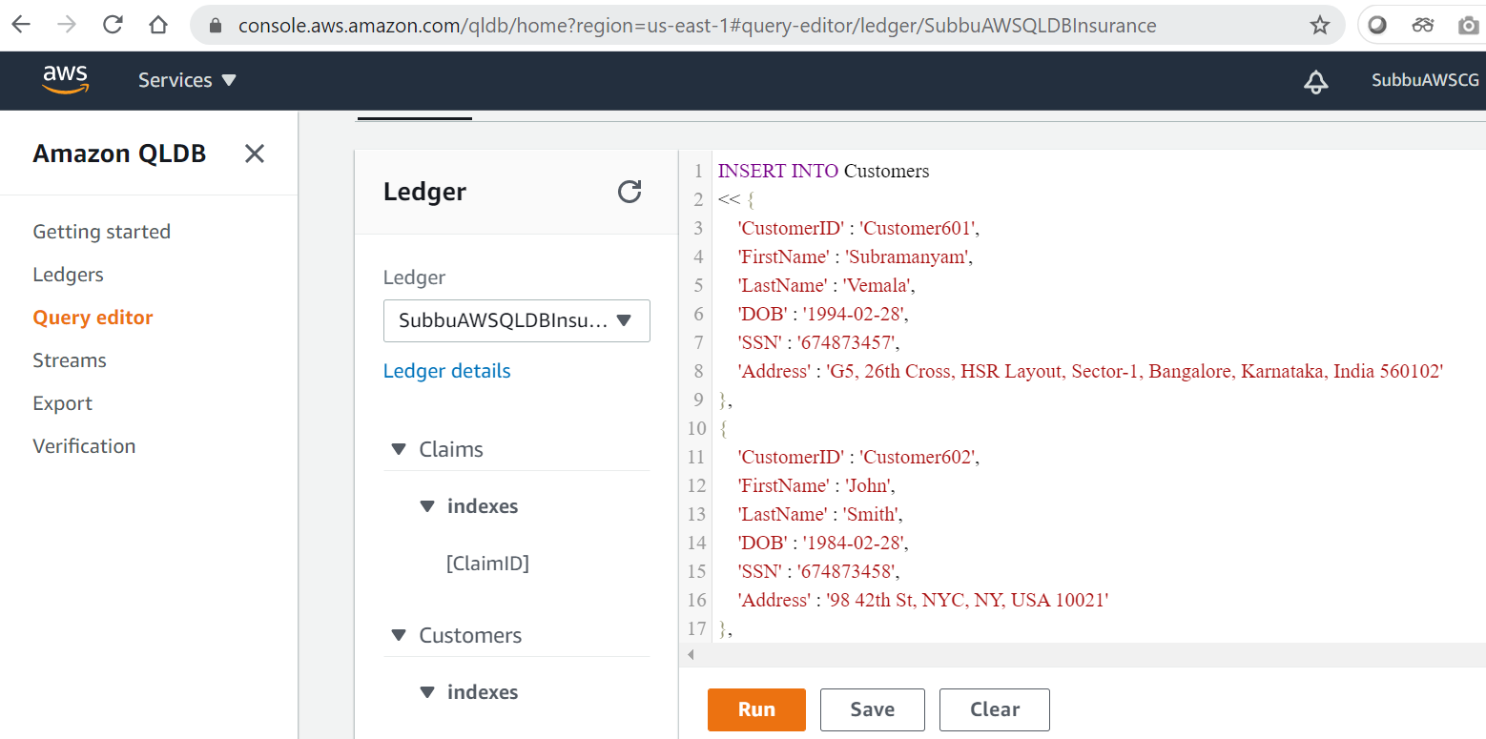
Step-4: Insert the sample data on all the three tables. Scripts are pushed in my github branch https://github.com/subbugh/aws-qldb:

Slide 19
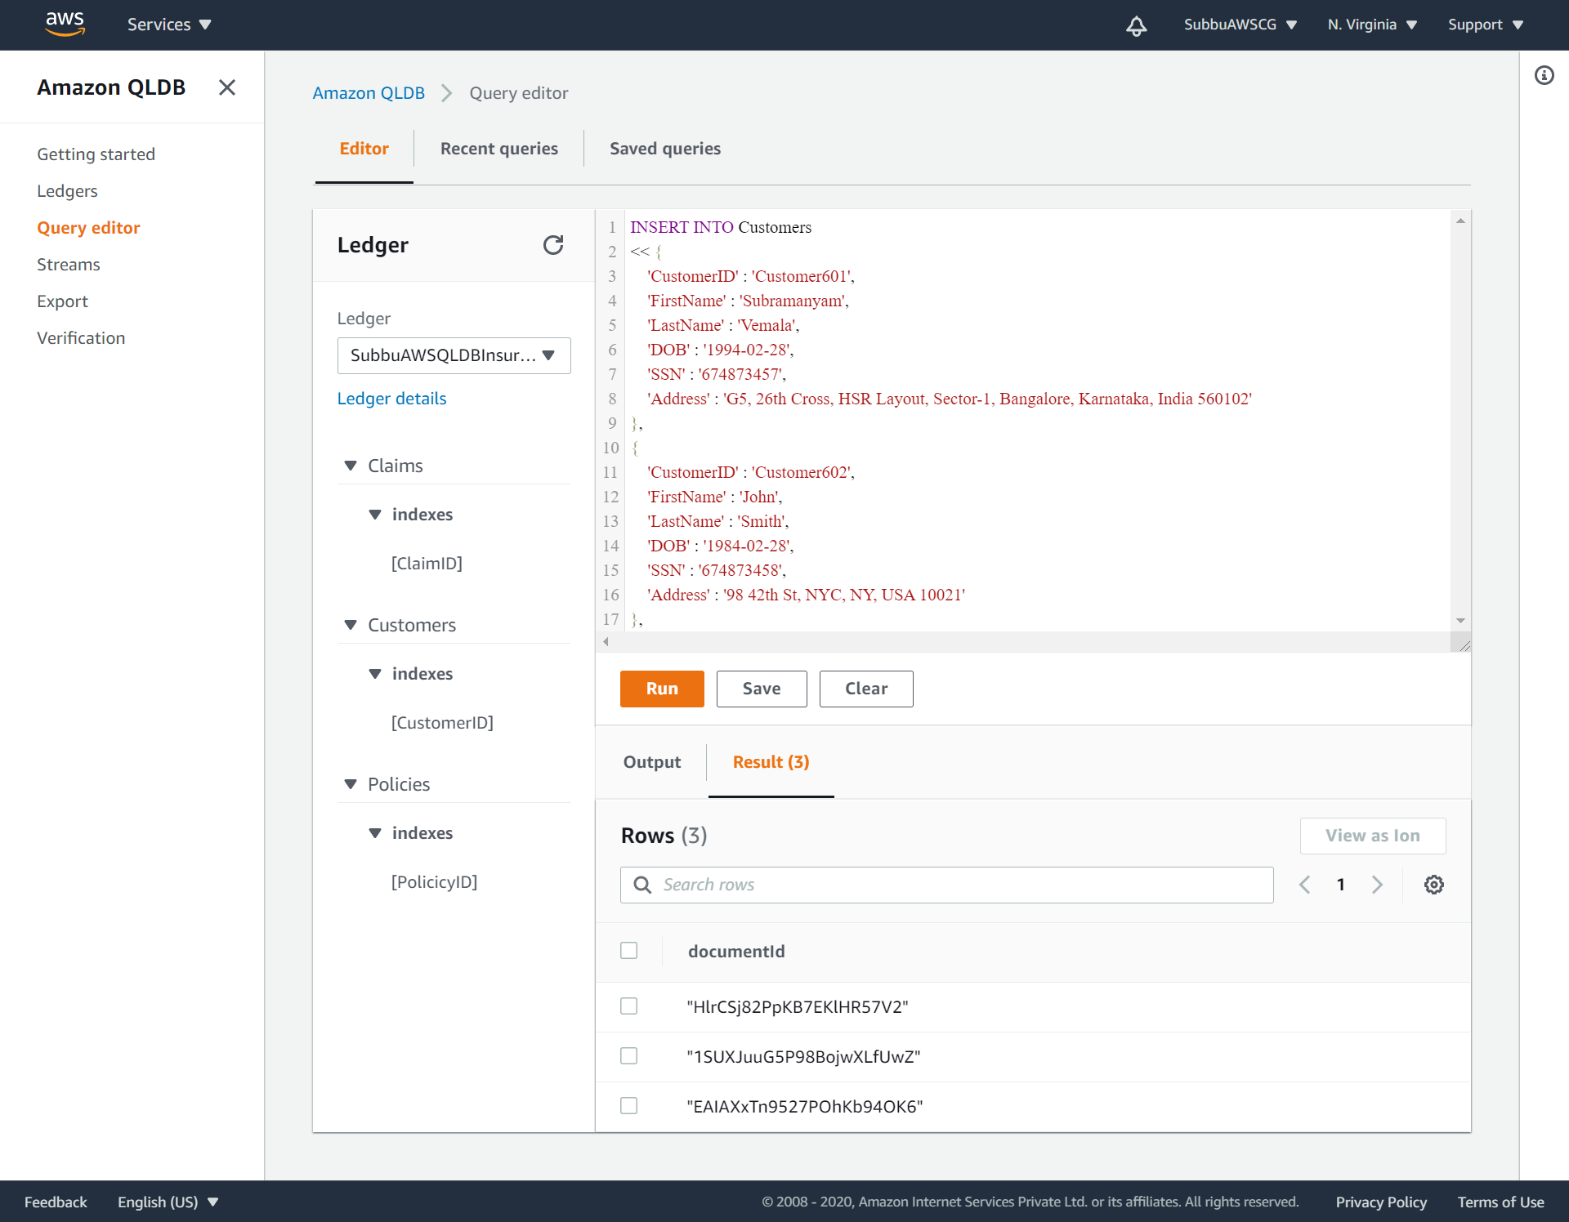
Sample data is inserted into the Customers table and three DocumentID’s are created:

Slide 20
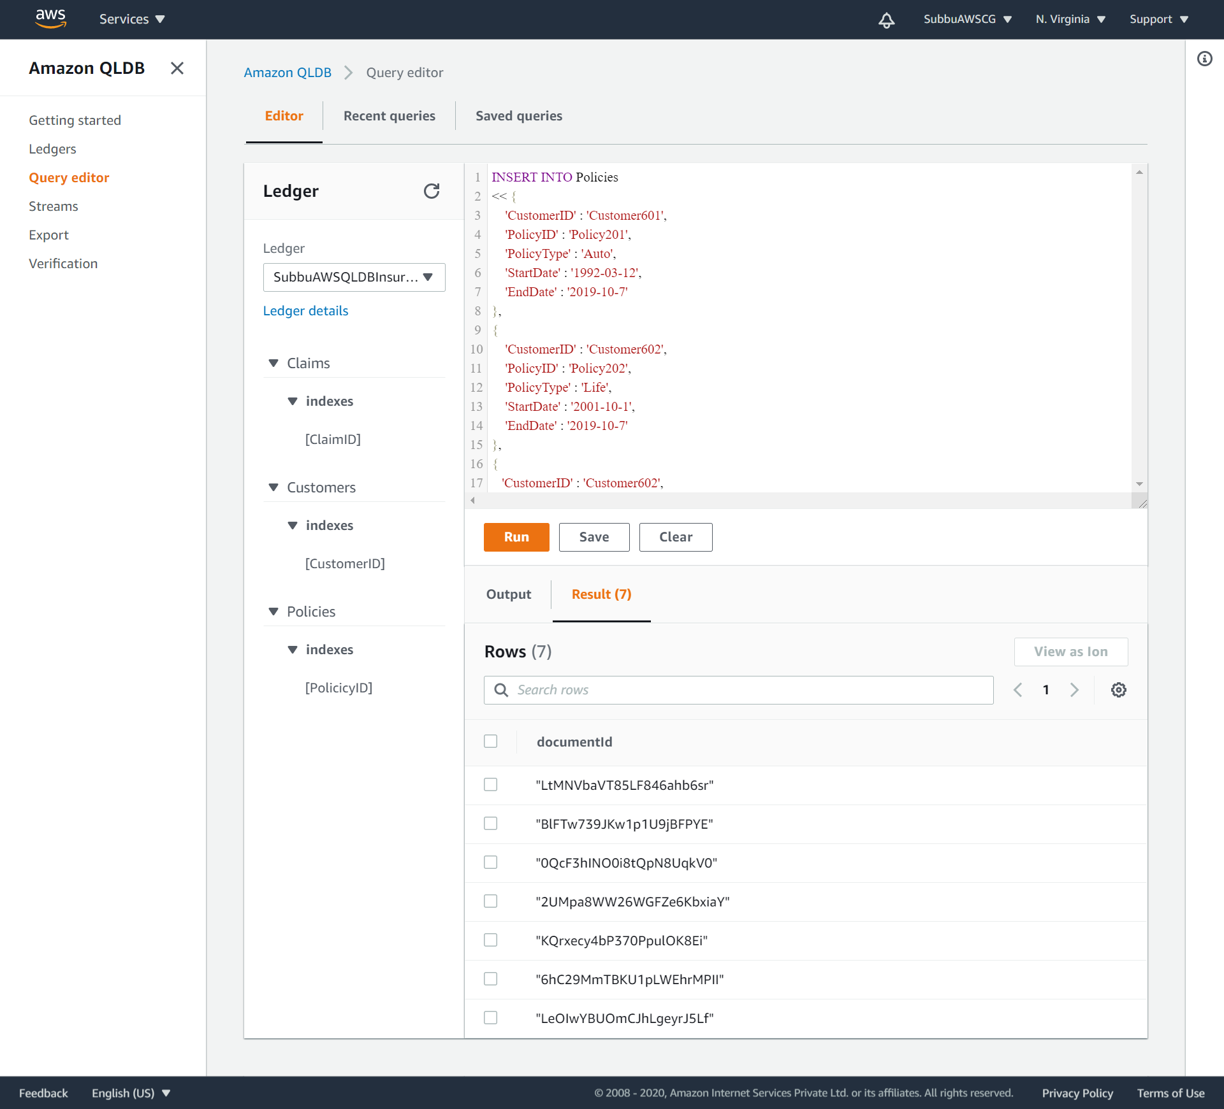
Sample data is inserted into the Policies table and relevant DocumentID’s are created:

Slide 21
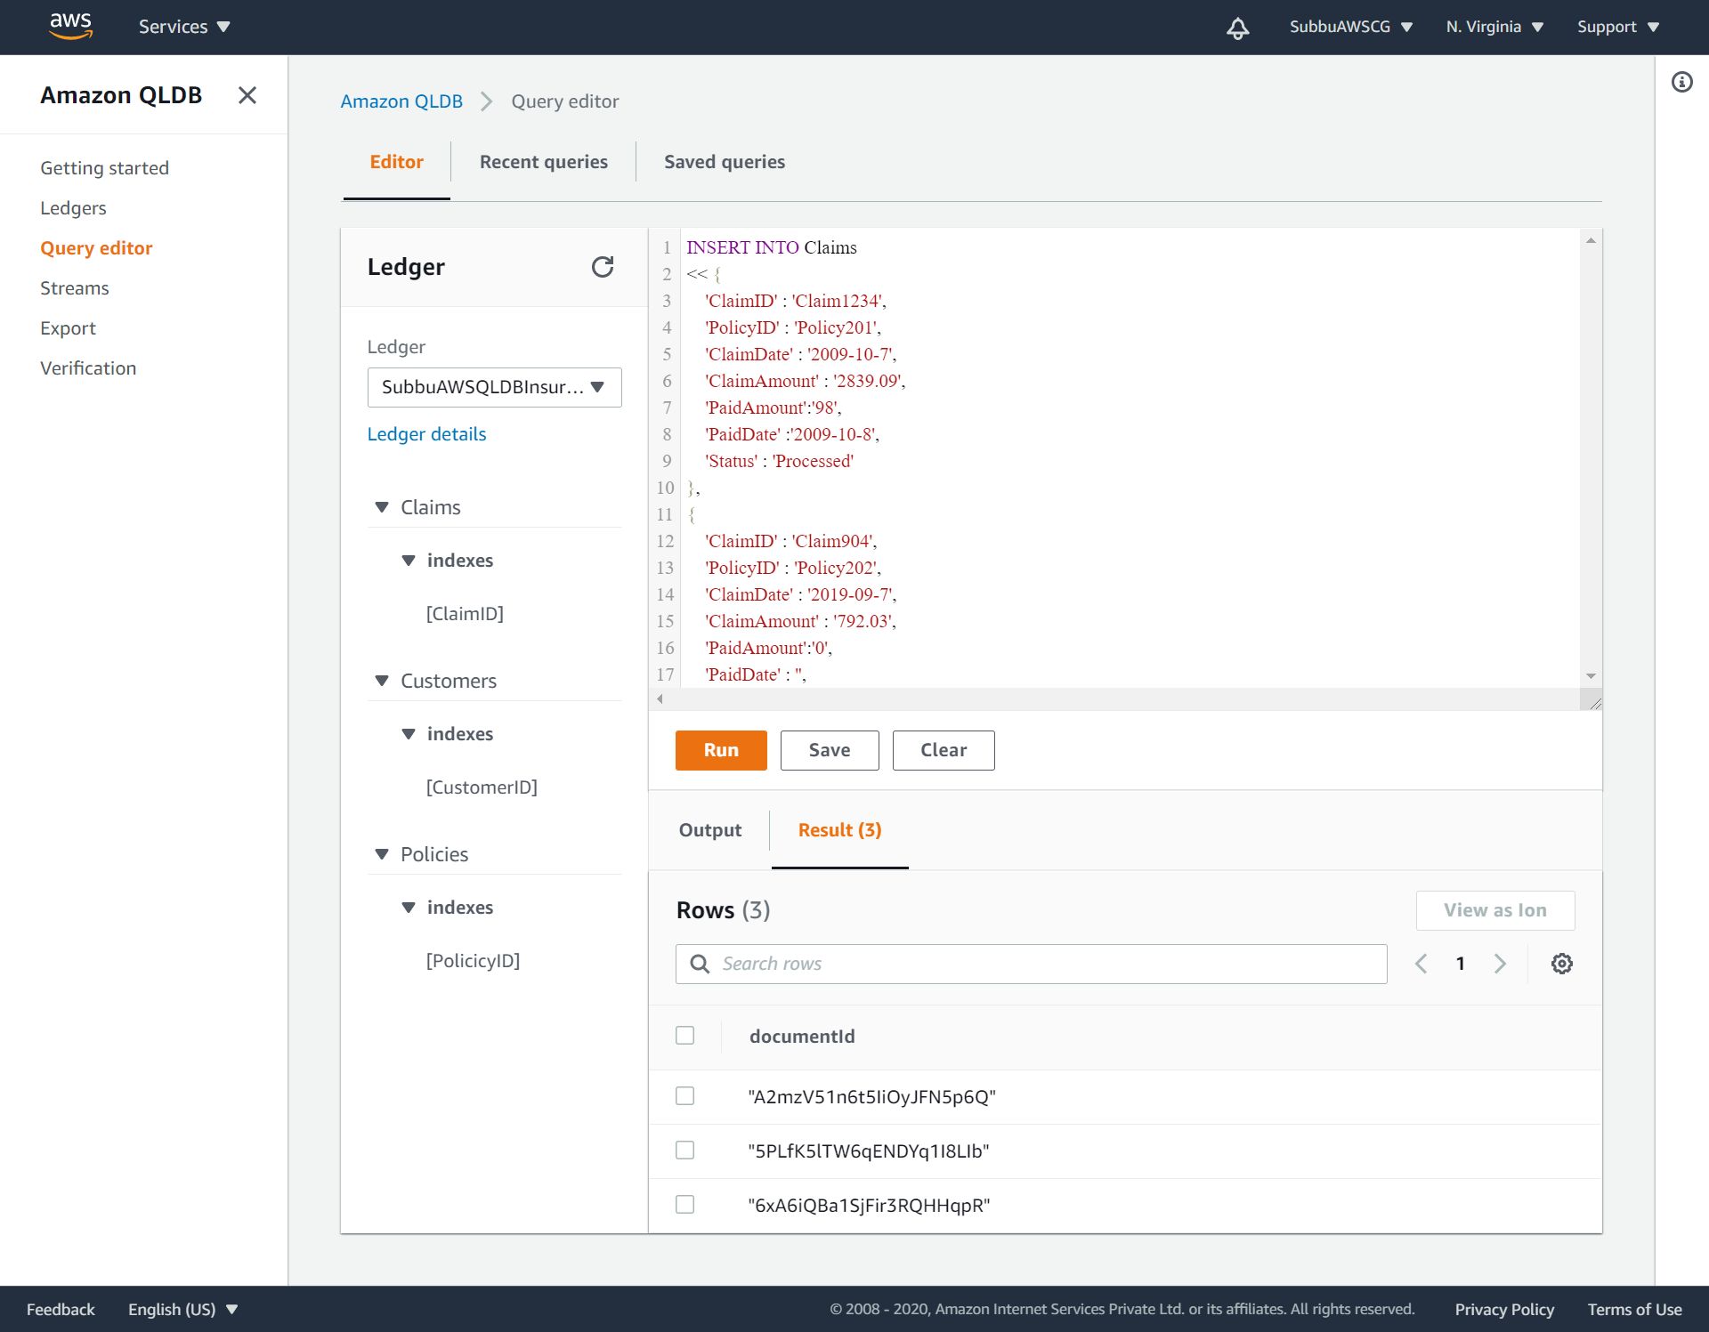
Sample data is inserted into the Claims table and relevant DocumentID’s are created:

Slide 22
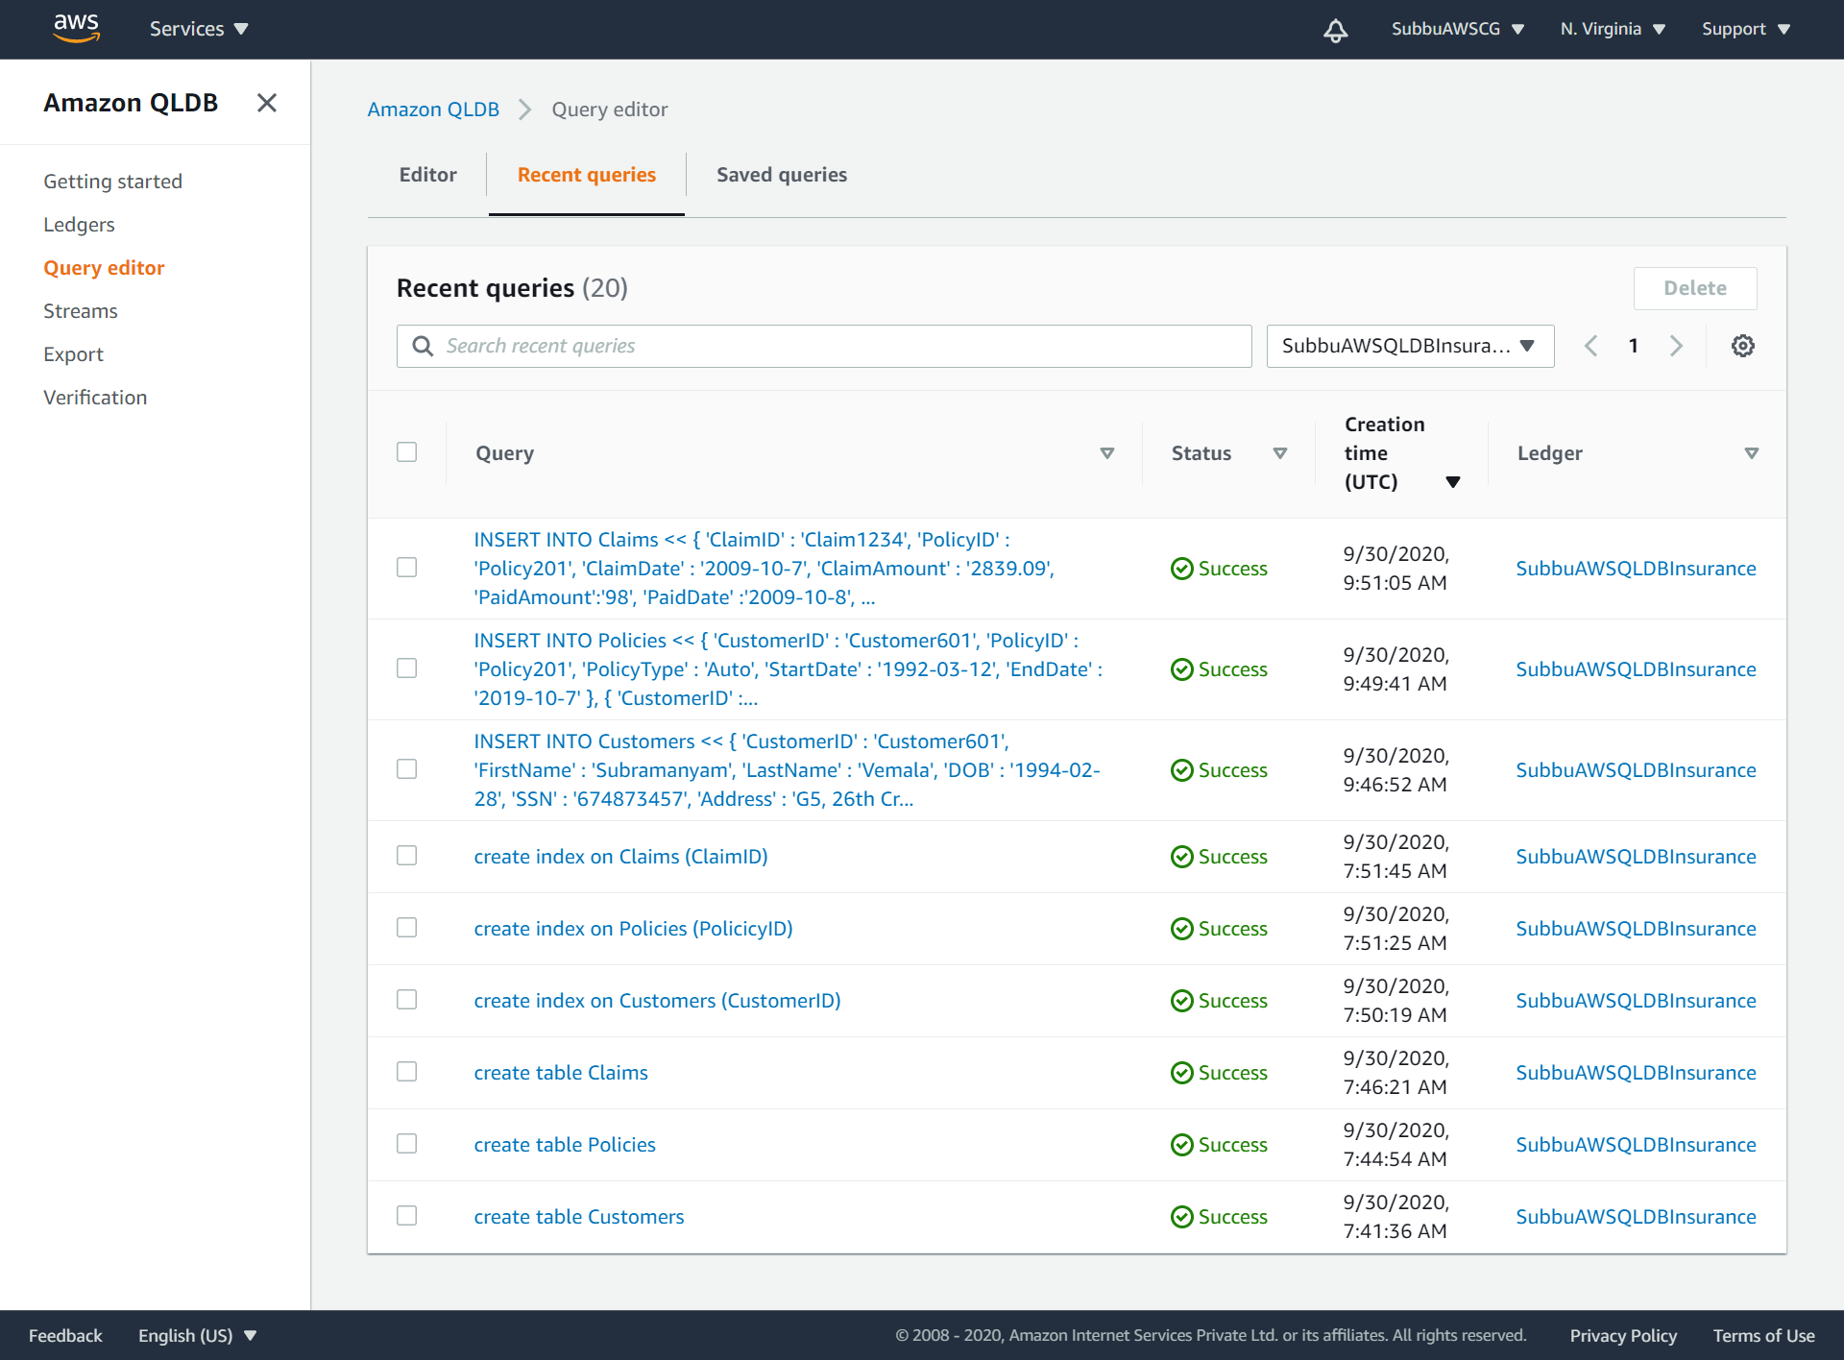
View the list of Recent Queries:

Slide 23
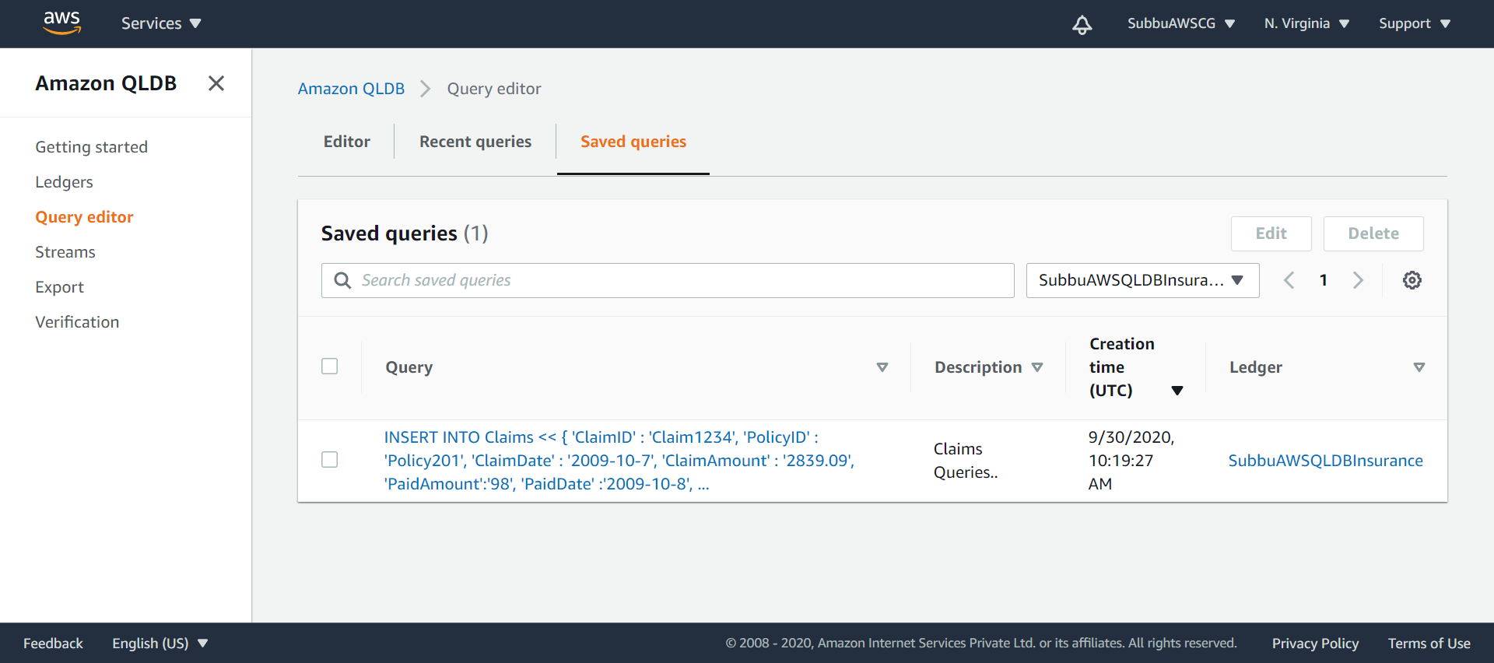
View the list of Saved queries:

Slide 24
Step-5: Query the tables on the ledger.
Step-6: Modify the data on the Ledger.
Step-7: Download a couple of Digest’s after set of Modify transactions.
The steps 5,6 and 7 are repeated, to generate the sufficient Data for validating the blocks of the transactions.
SetOfUpdates-1 on the Claims table for the ClaimsID=‘Claim904’

Slide 25
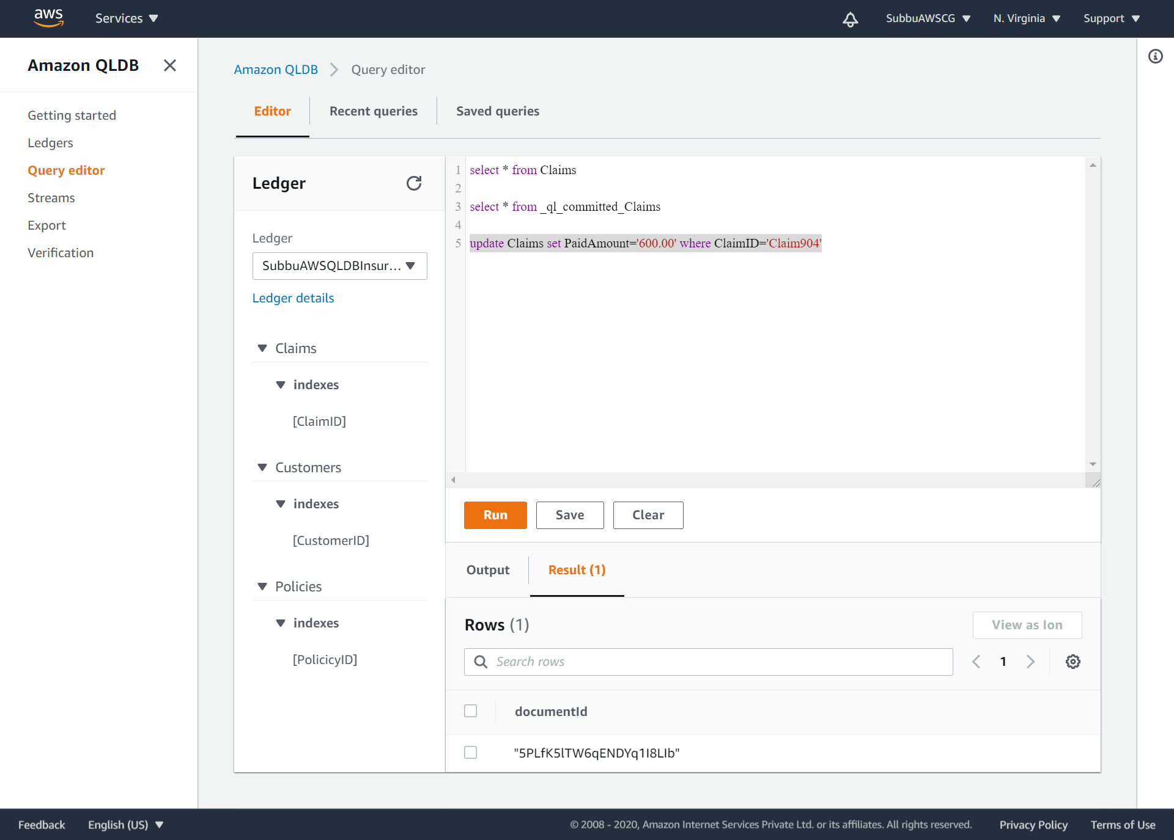
SetOfUpdates-1: update Claims set PaidAmount=‘600.00’ where ClaimID=‘Claim904’.

Slide 26
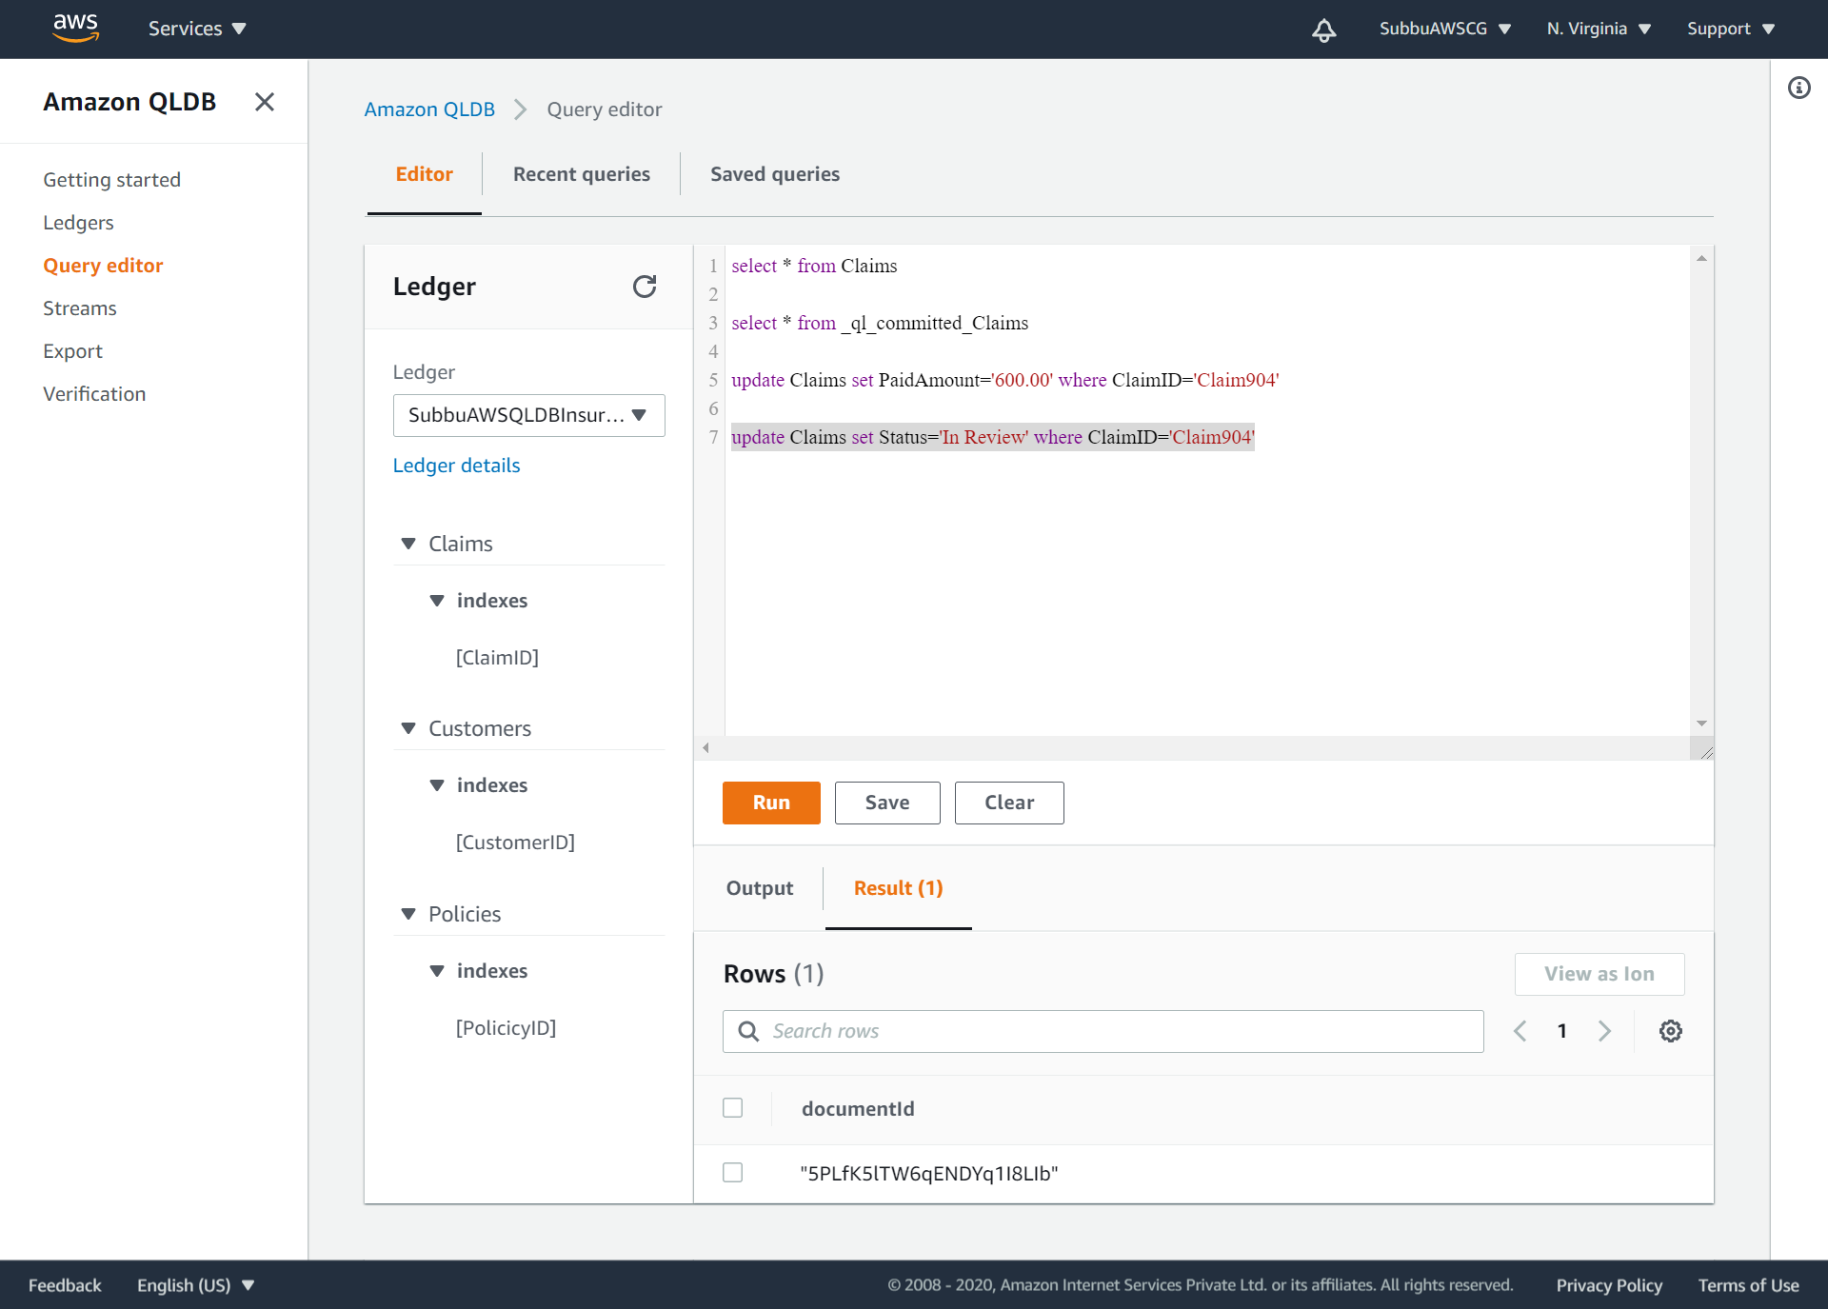
SetOfUpdates-1: update Claims set Status=‘In Review’ where ClaimID=‘Claim904’:

Slide 27
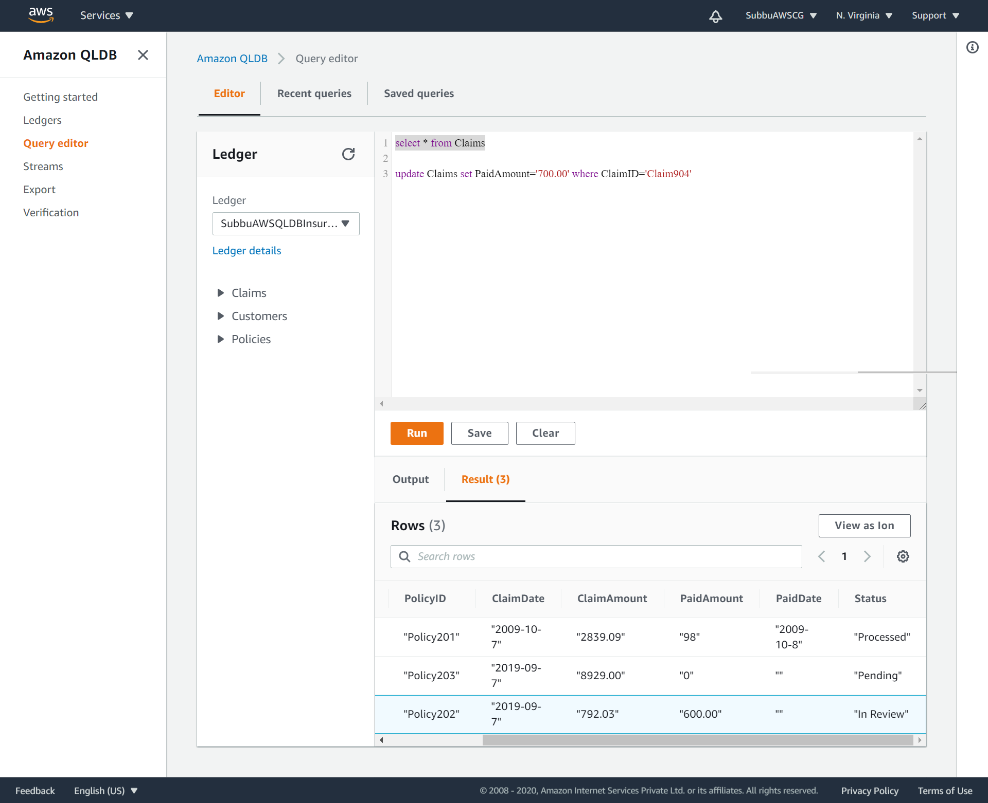
SetOfUpdates-1: select * from Claims: See the updated values of PaidAmount and the Status.

Slide 28
Get the Digest-1, after performing the SetOfUpdates-1 statements as above

Slide 29
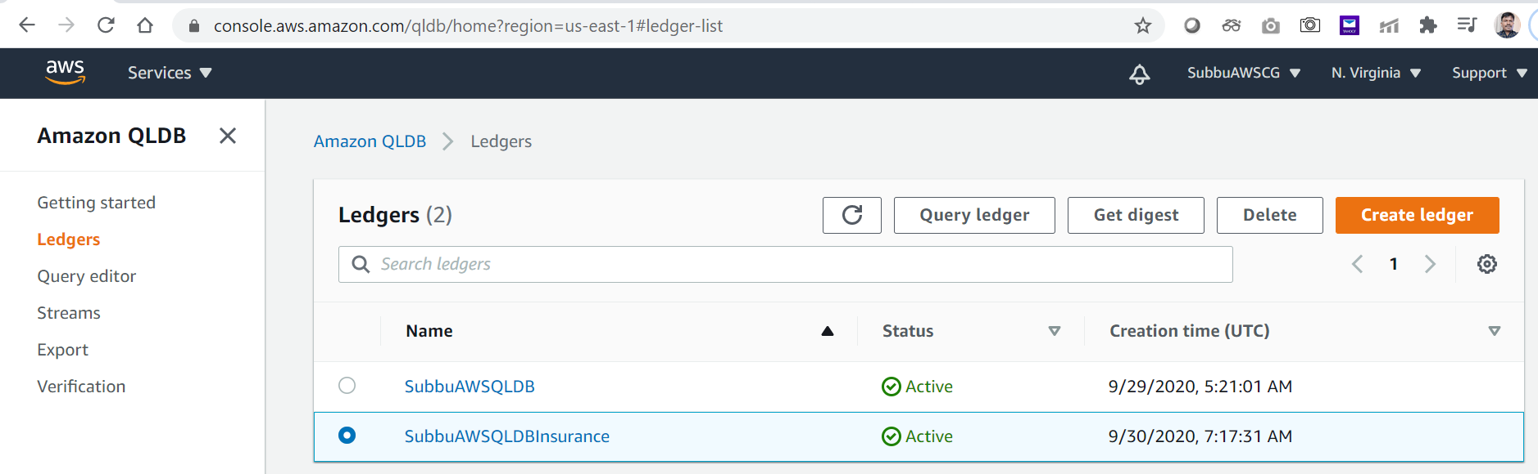
Get Digest-1: Choose the Ledger and Click on the Digest.

Slide 30
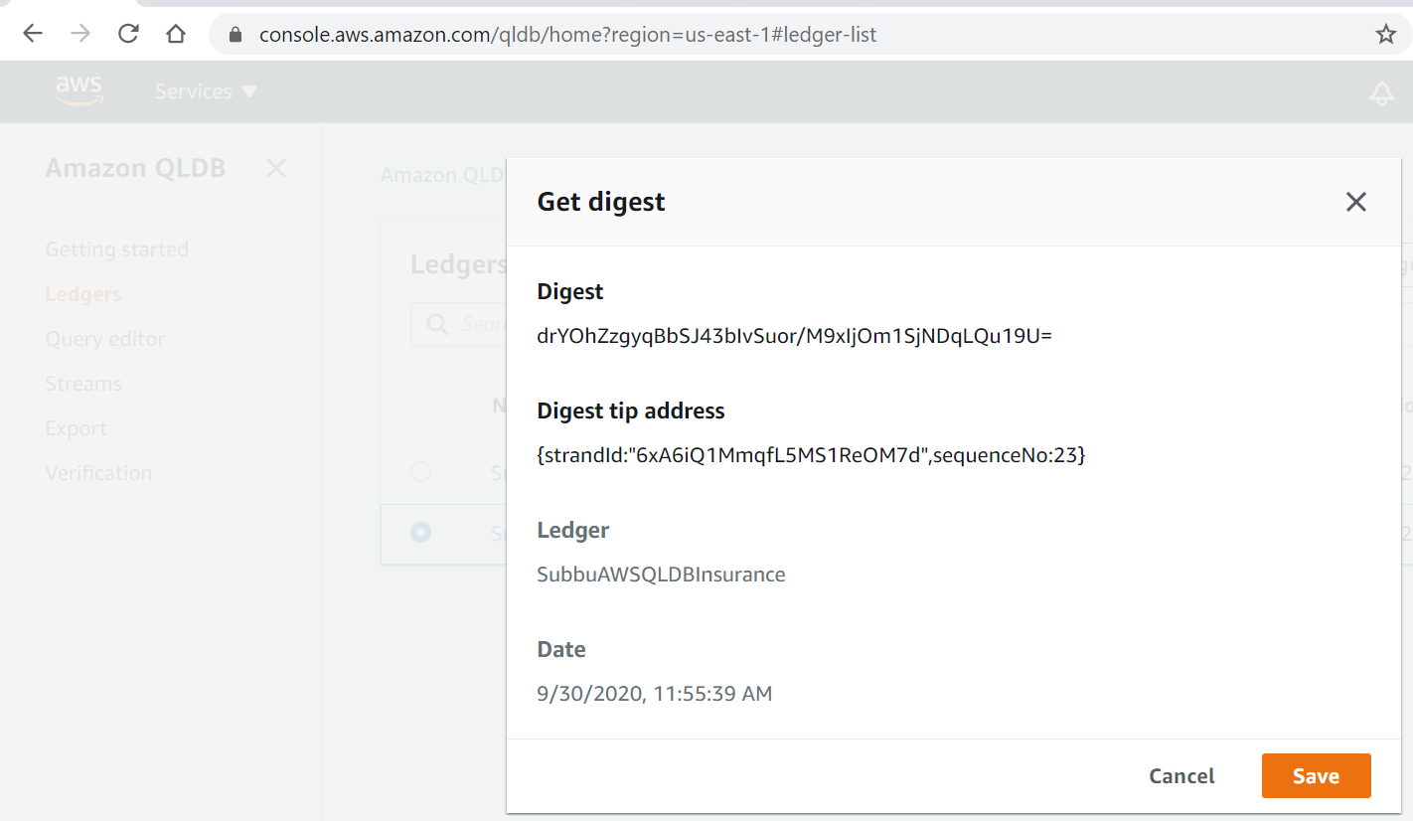
Specify the path to Save the Digest on your system:

Slide 31
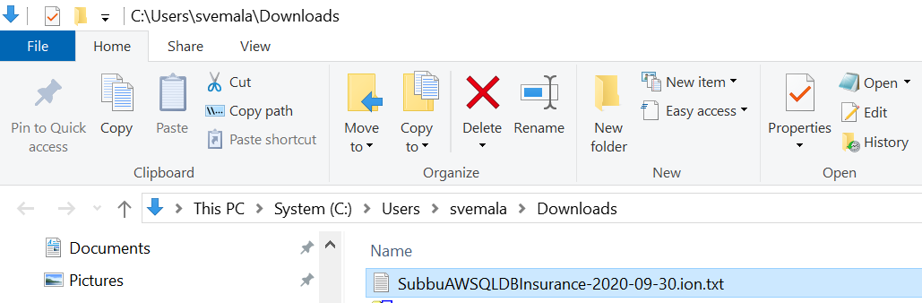
Digest-1, is downloaded:

Slide 32
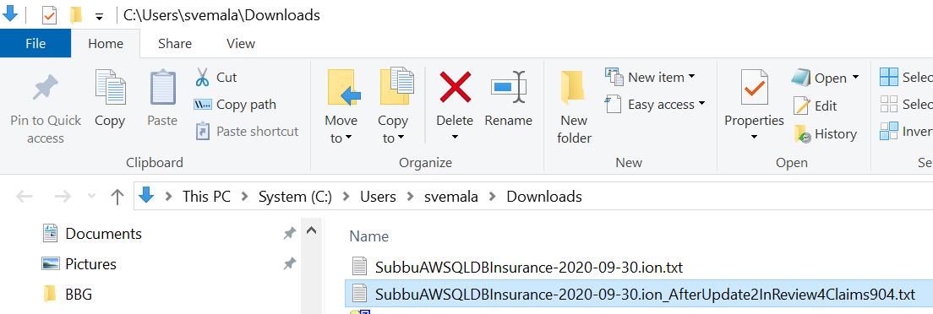
Rename the Digest-1, downloaded to a meaningful name, so that which will be easy to verify in the Step-8.

Slide 33
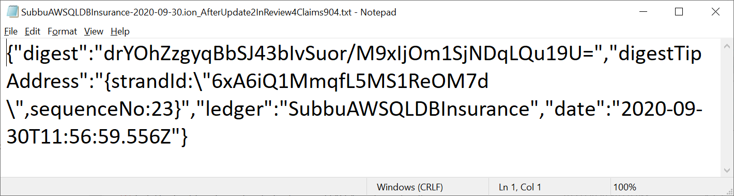
View of a downloaded Digest-1:

Slide 34
Get metadata of Claims table

Slide 35
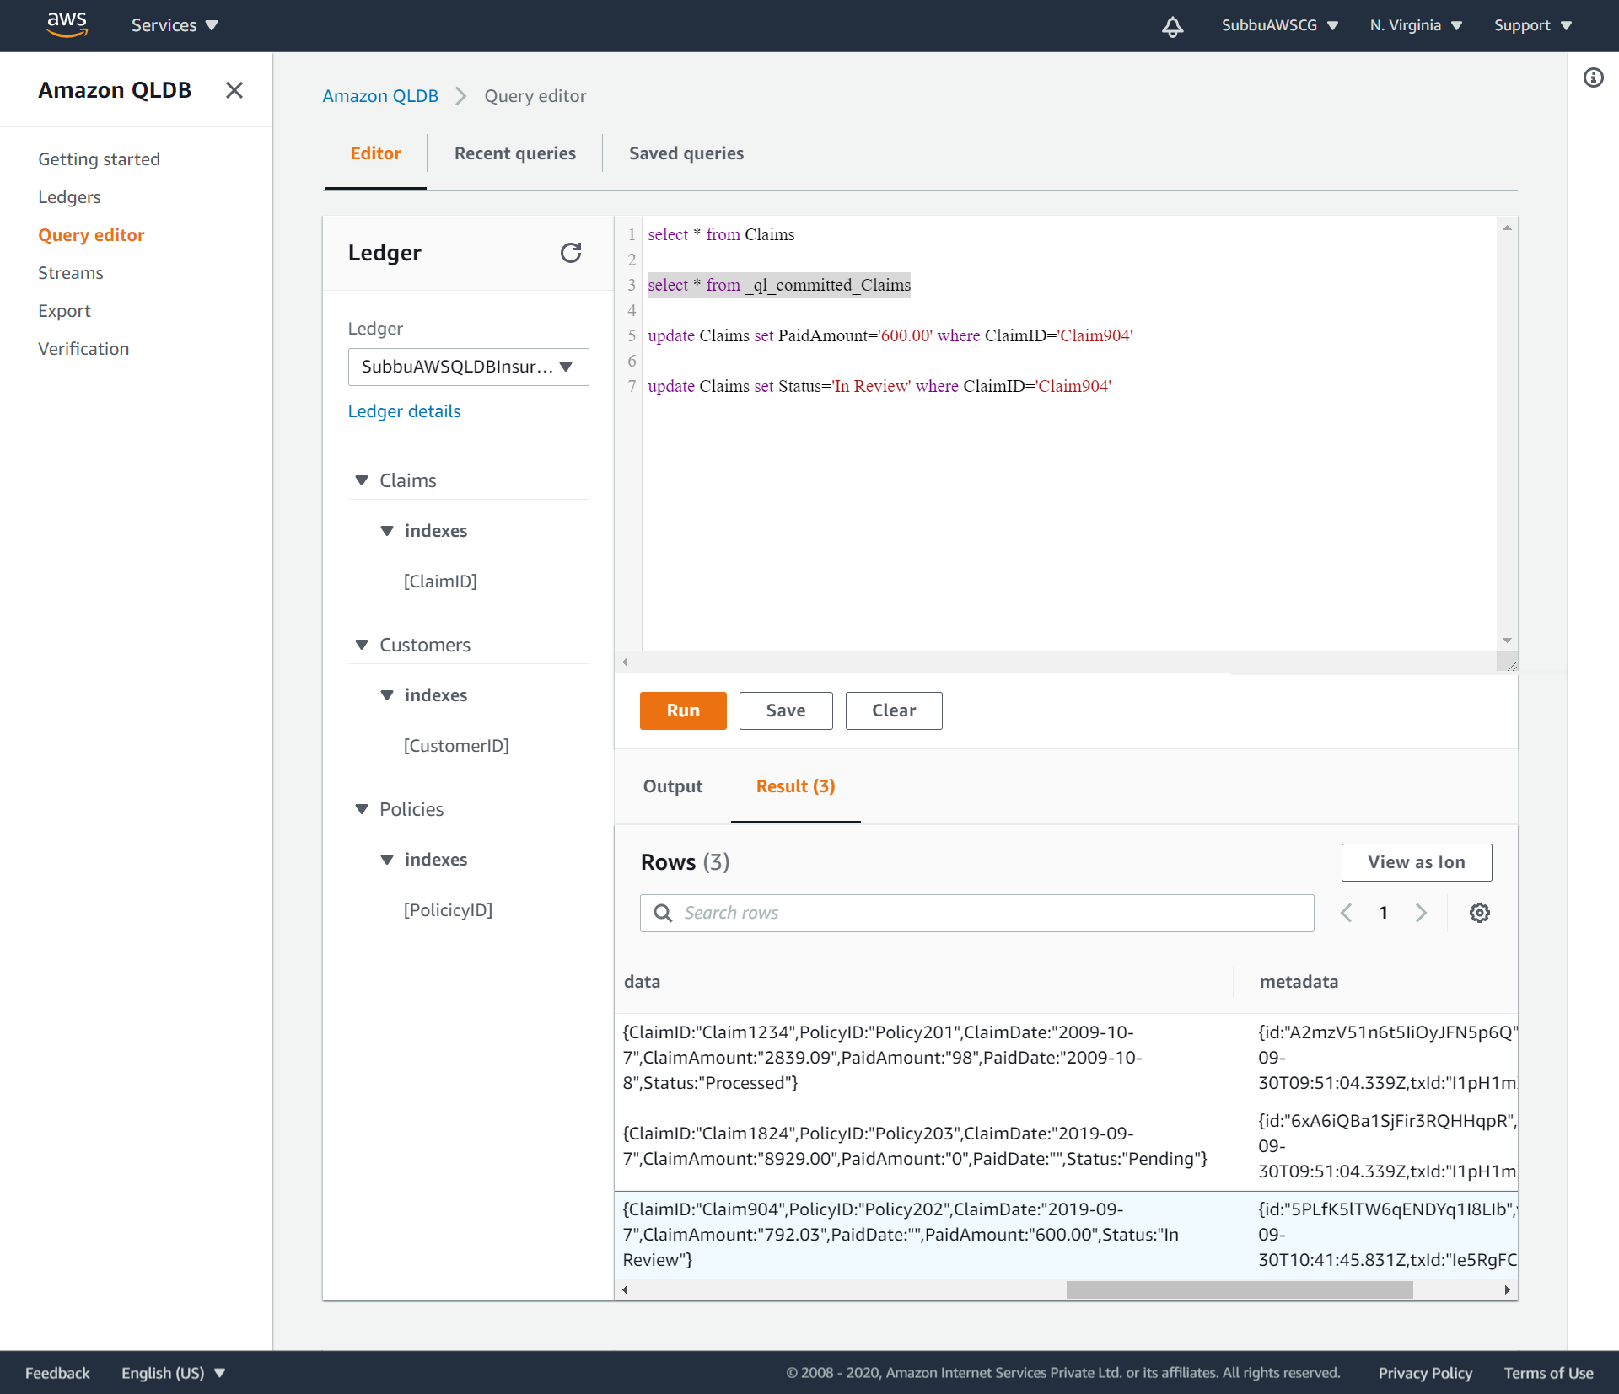
Get metadata of Claims table: select * from _ql_committed_Claims

Slide 36
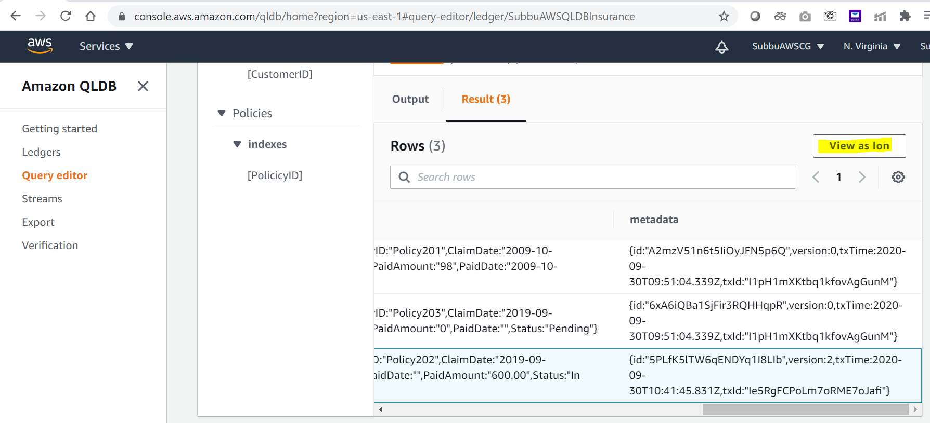
View as Ion for a specific ClaimsID:

Slide 37
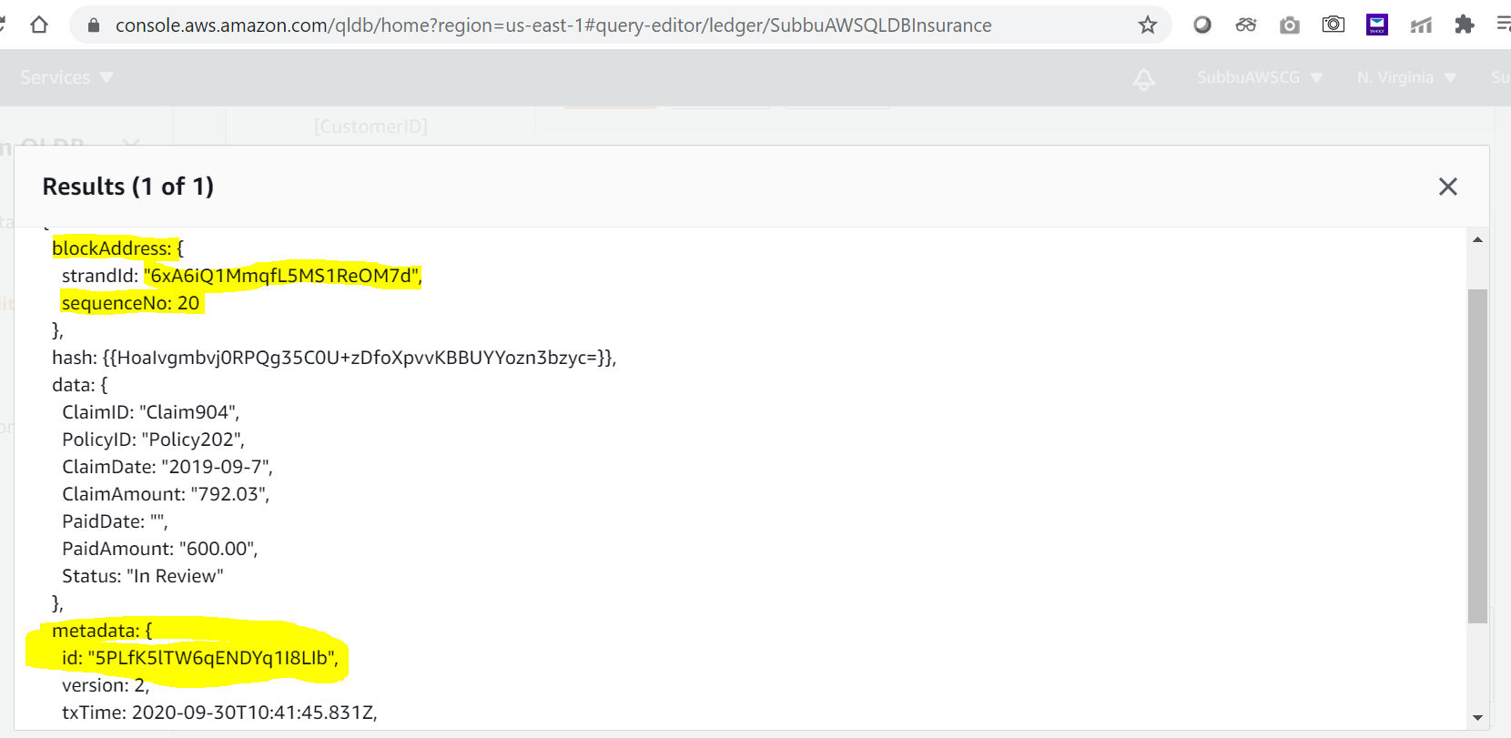
Get the metadata ID for a specific ClaimsID:

Slide 38
Check the history of ClaimID using metadataID

Slide 39
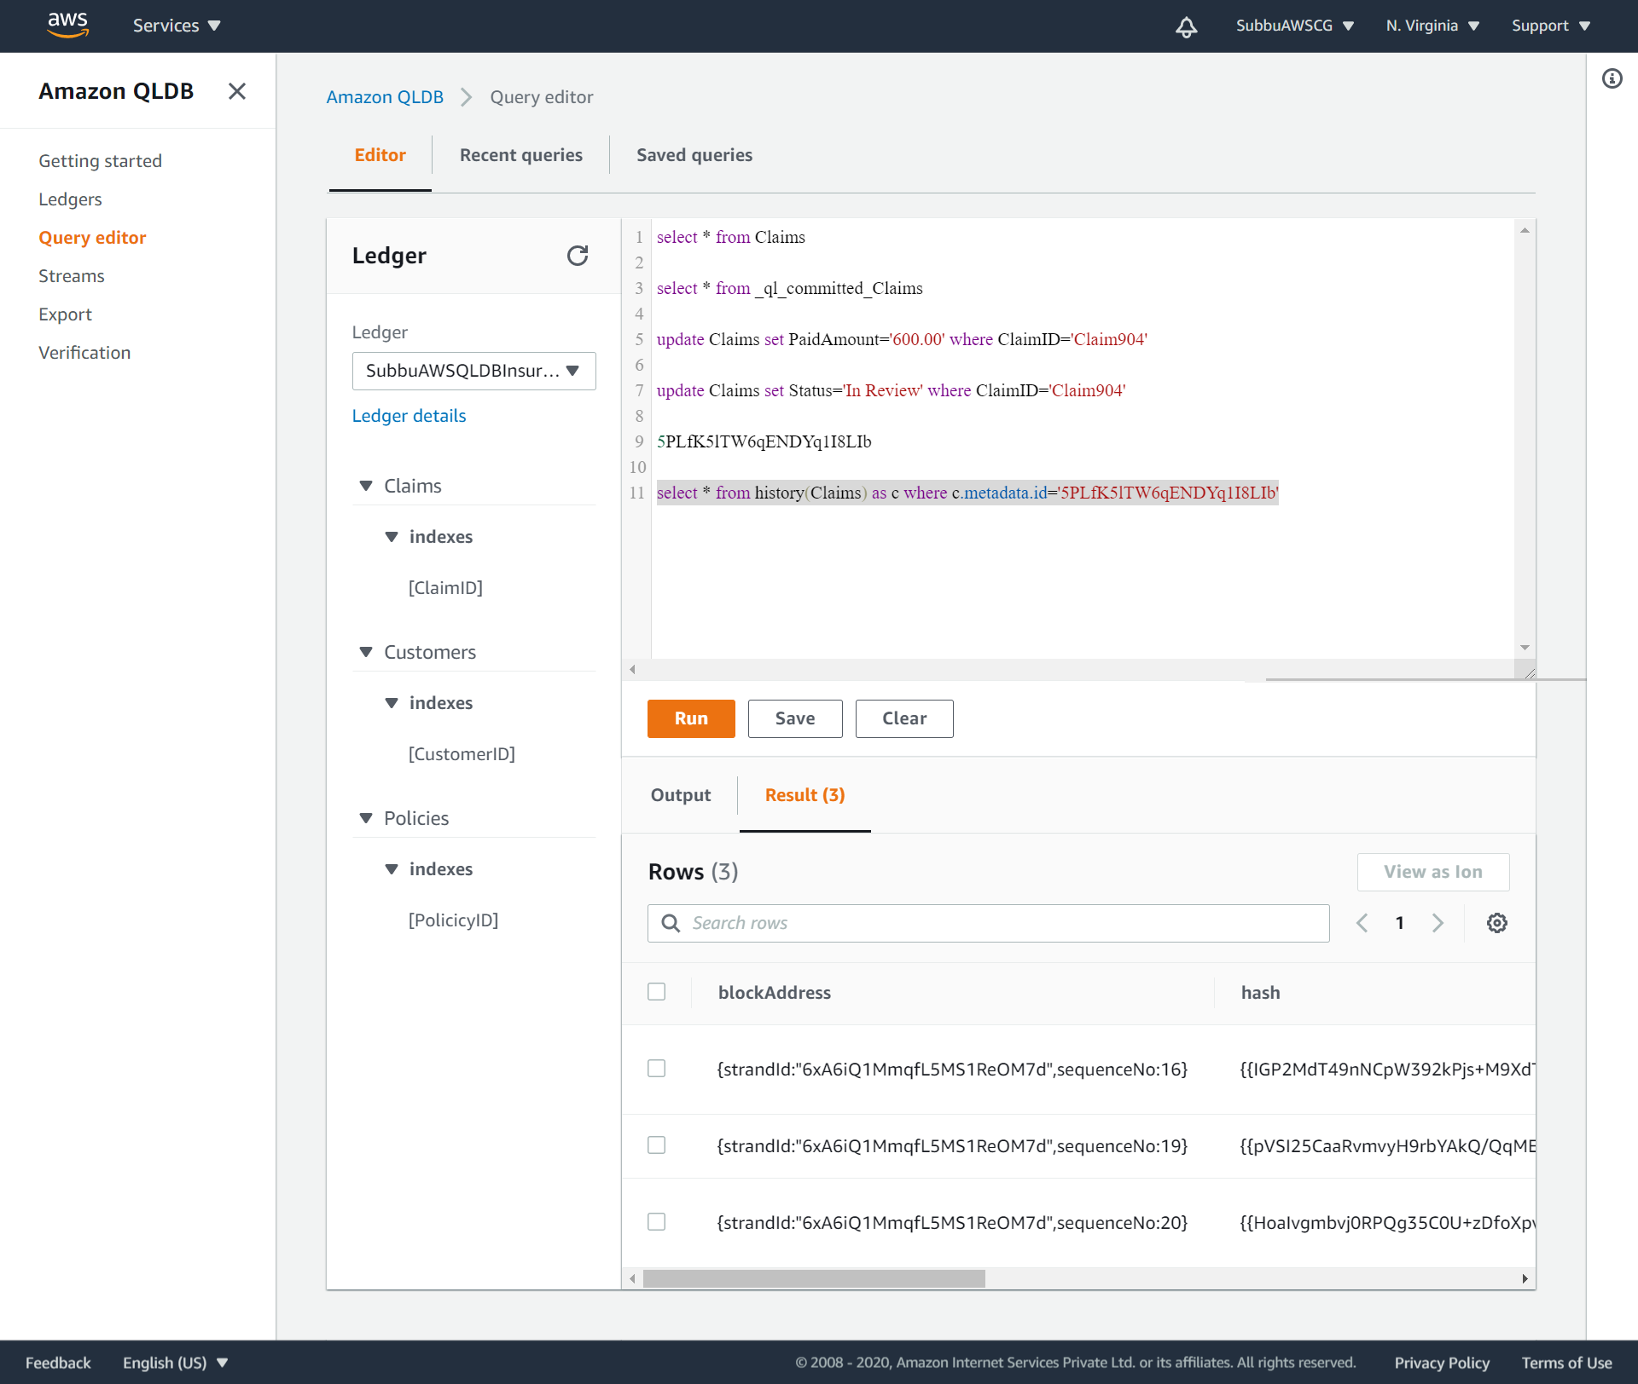
Check the history of a ClaimsID, using its metadata ID: select * from history(Claims) as c where c.metadata.id='5PLfK5lTW6qENDYq1I8LIb'

Slide 40
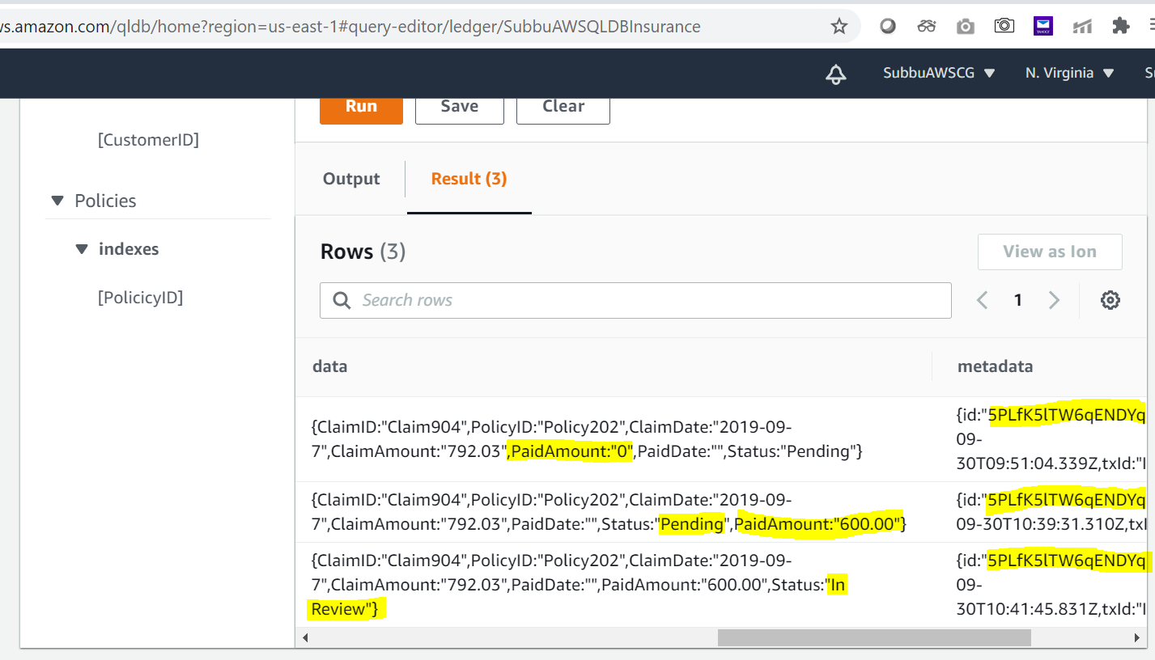
Claims table history for a specific ClaimsID:

Slide 41
Repeat the process of performing update the data on the tables and downloading the Digest’s.
SetOfUpdates-2, as below.

Slide 42
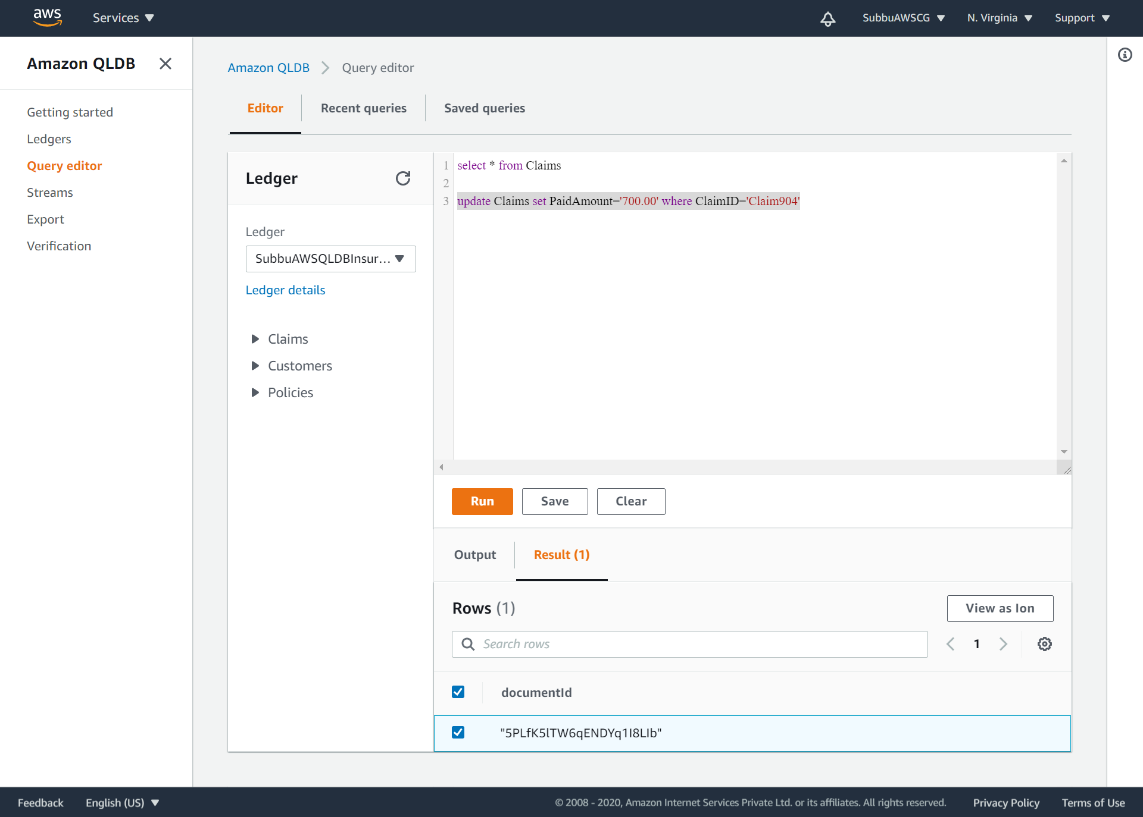
SetOfUpdates-2: update Claims set PaidAmount='700.00' where ClaimID='Claim904‘:

Slide 43
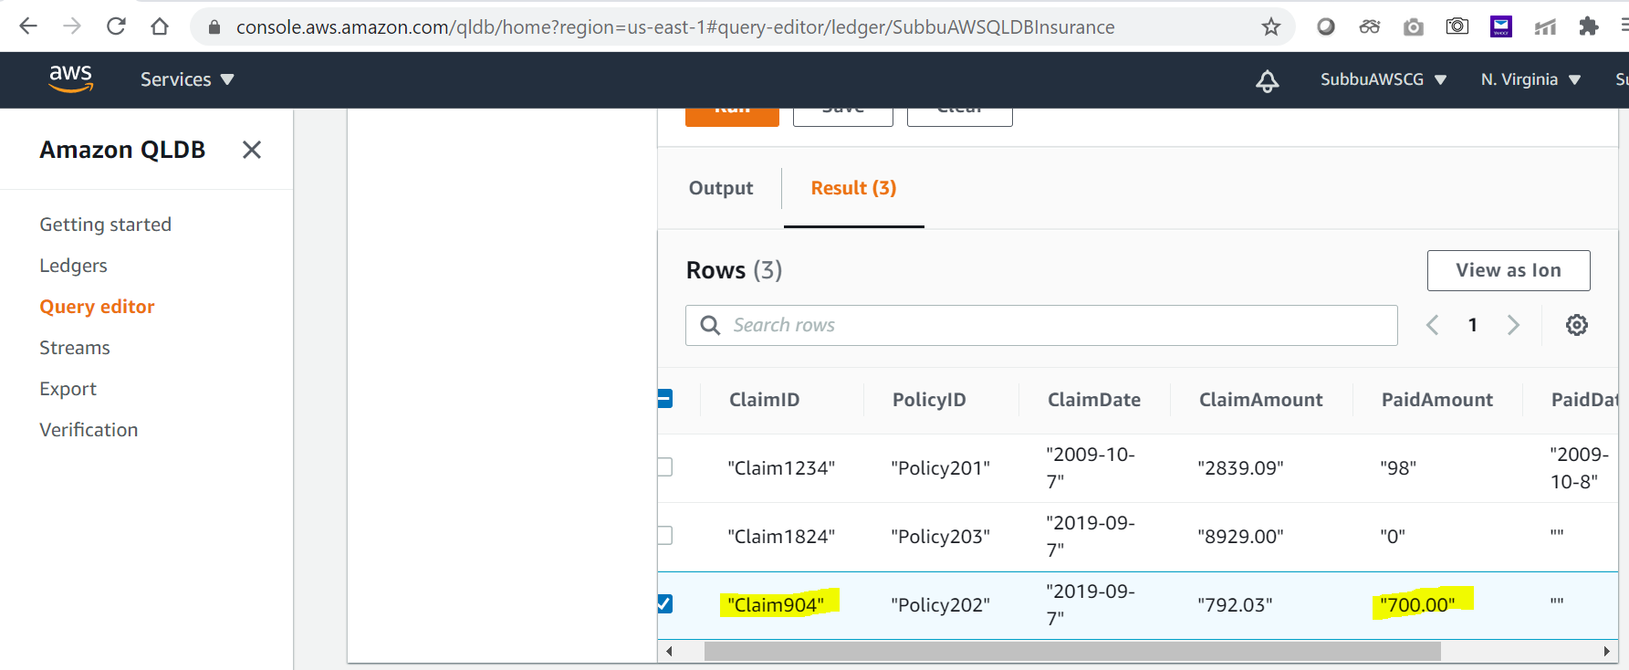
Validate the changes:

Slide 44
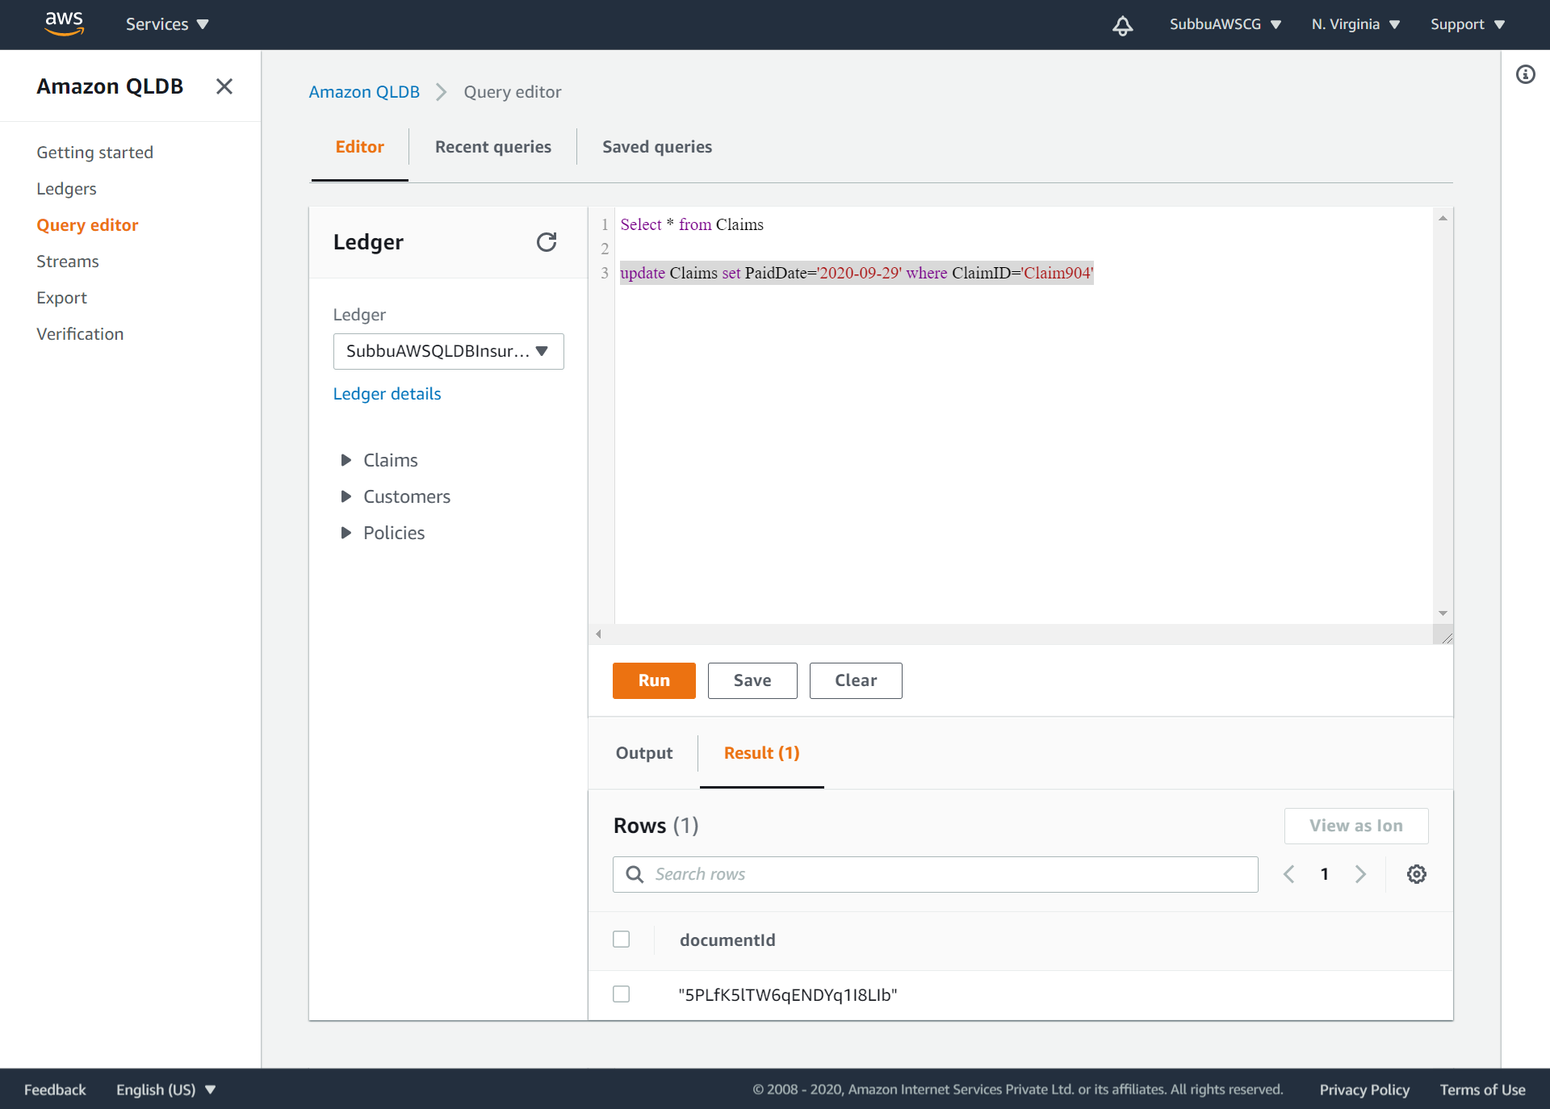
SetOfUpdates-2: update Claims set PaidDate='2020-09-29' where ClaimID='Claim904‘:

Slide 45
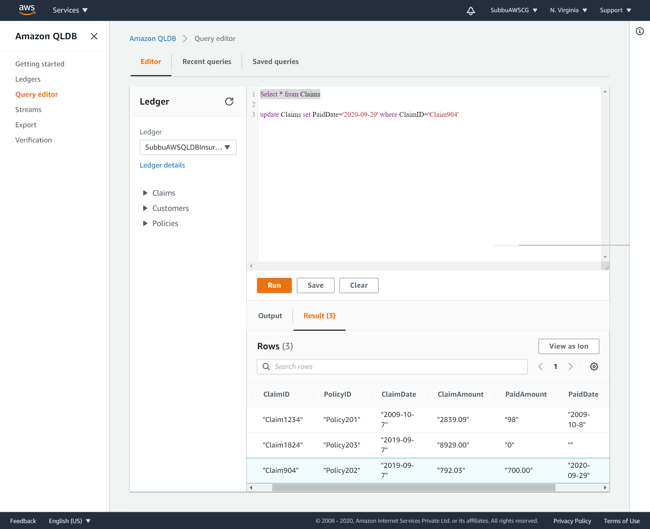
Validate the changes:

Slide 46
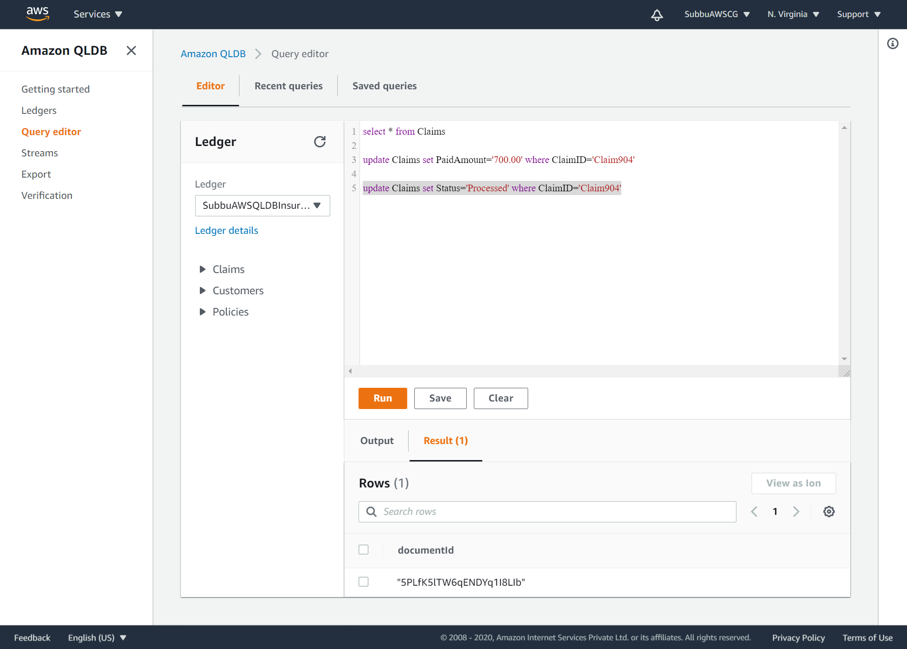
SetOfUpdates-2: update Claims set Status='Processed' where ClaimID='Claim904‘:

Slide 47
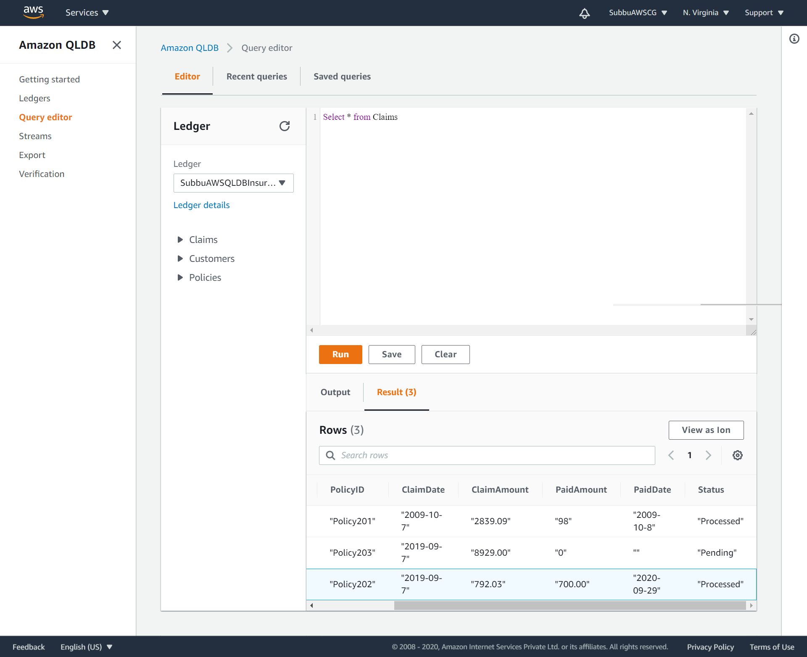
Crosscheck the updated value in the Claims table:

Slide 48
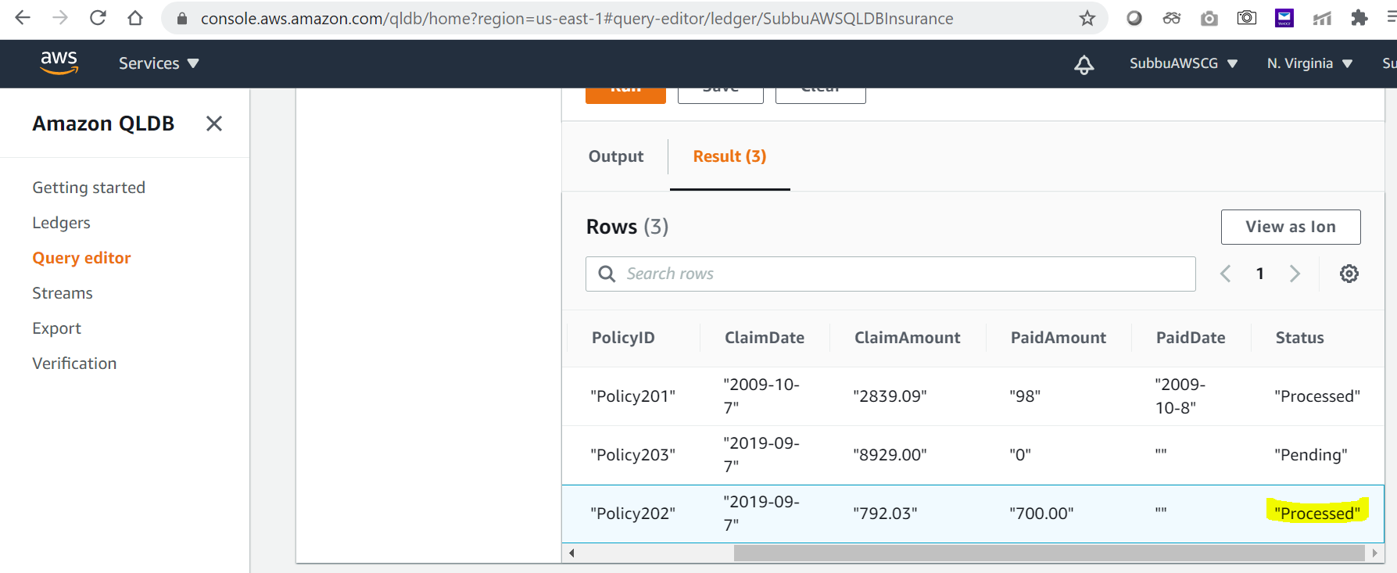
Crosscheck the updated value in the Claims table:

Slide 49
Get the Digest-2, after the SetOfUpdates-2 (updating the PaidAmount=‘700.00’, PaidDate='2020-09-29' and ClaimStatus=‘Processed’ for the ClaimID=‘Claims904’) is executed.

Slide 50
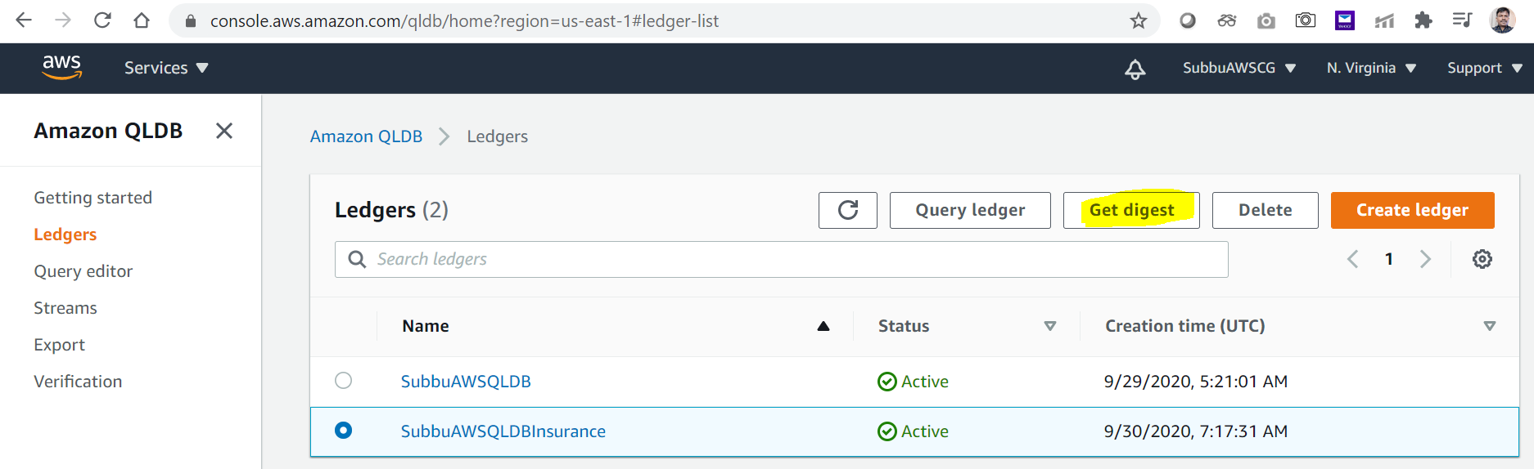
“Get Digest-2”, after the SetOfUpdates-2.

Slide 51
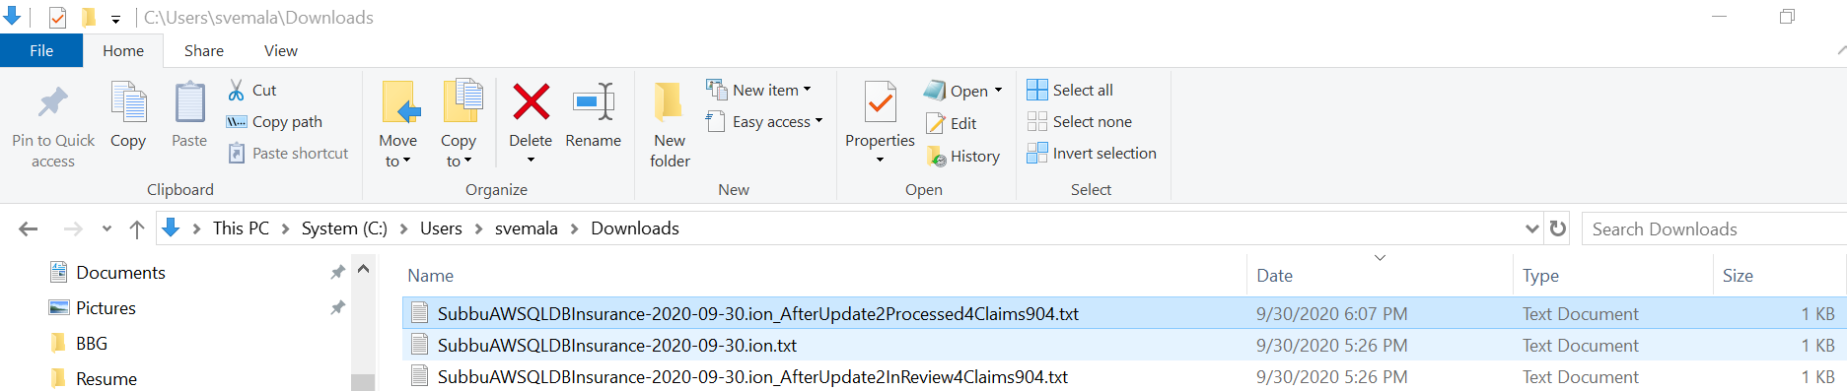
Rename the downloaded Digest-2 text file to proper name as below:

Slide 52
Perform the 3rd Set of Updates, as SetOfUpdates-3 for the Claim904

Slide 53
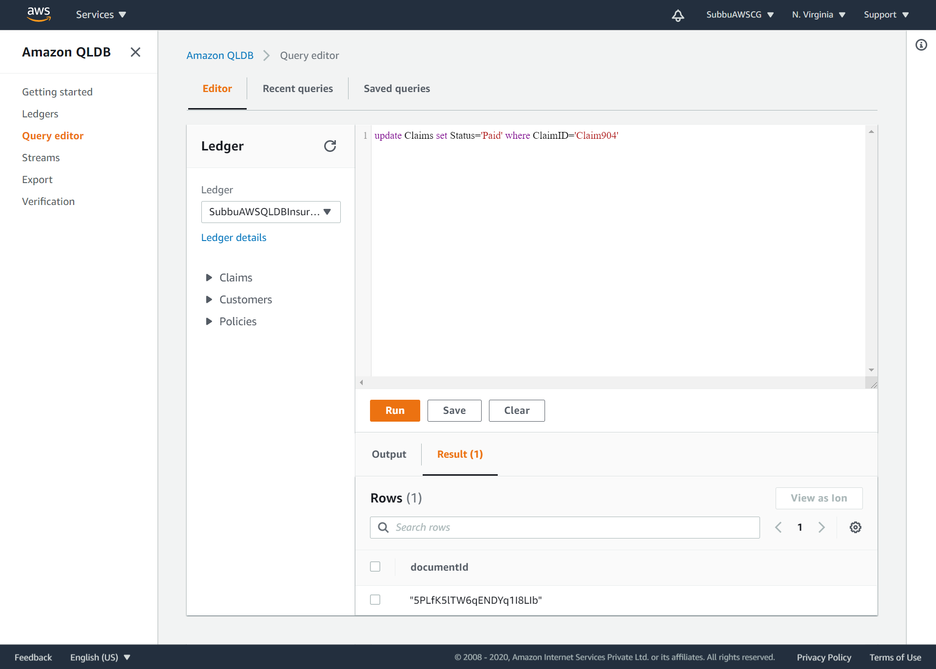
SetOfUpdates-3: update Claims set Status='Paid' where ClaimID='Claim904'

Slide 54
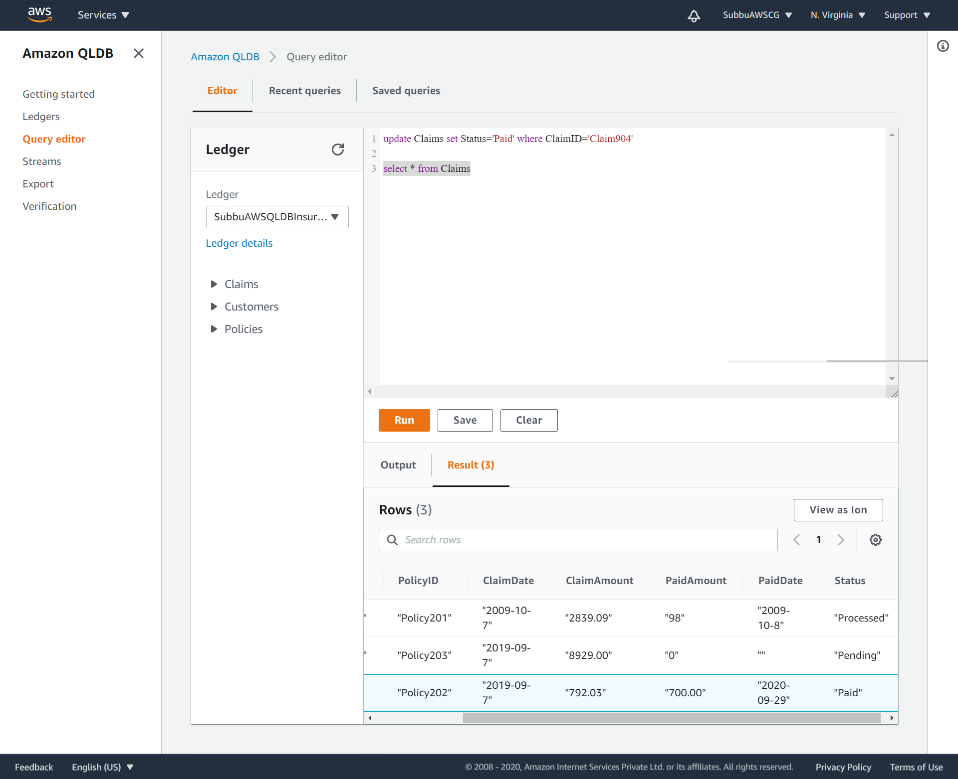
Select * from Claims:

Slide 55
Get the Digest-3, after SetOfUpdates-3 (changing the ClaimStatus to Paid)

Slide 56
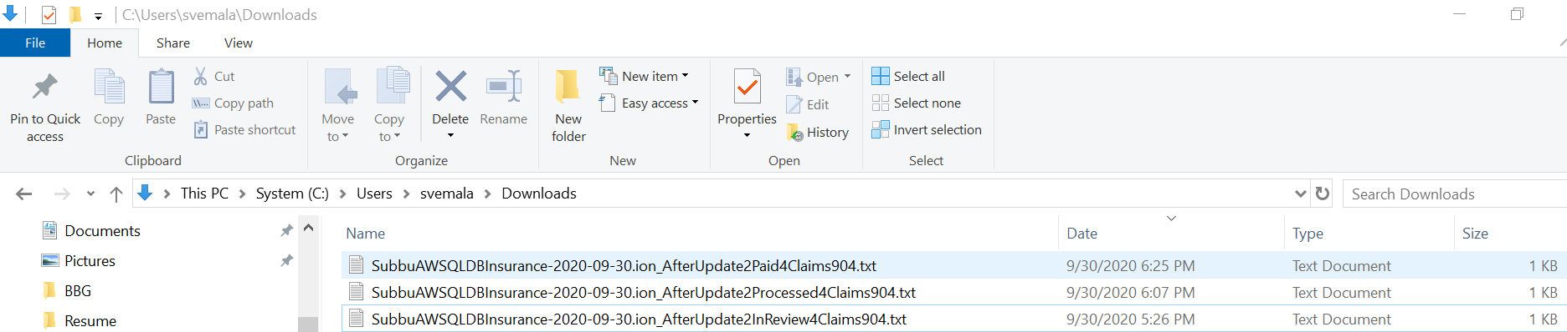
Get Digest-3, after the claim status updated to Paid for the Claim904:

Slide 57
Check the History for the ClaimsID, Claim904 in the Claims tables and list down all the Revisions performed for a specific Claims ID as below.

Slide 58
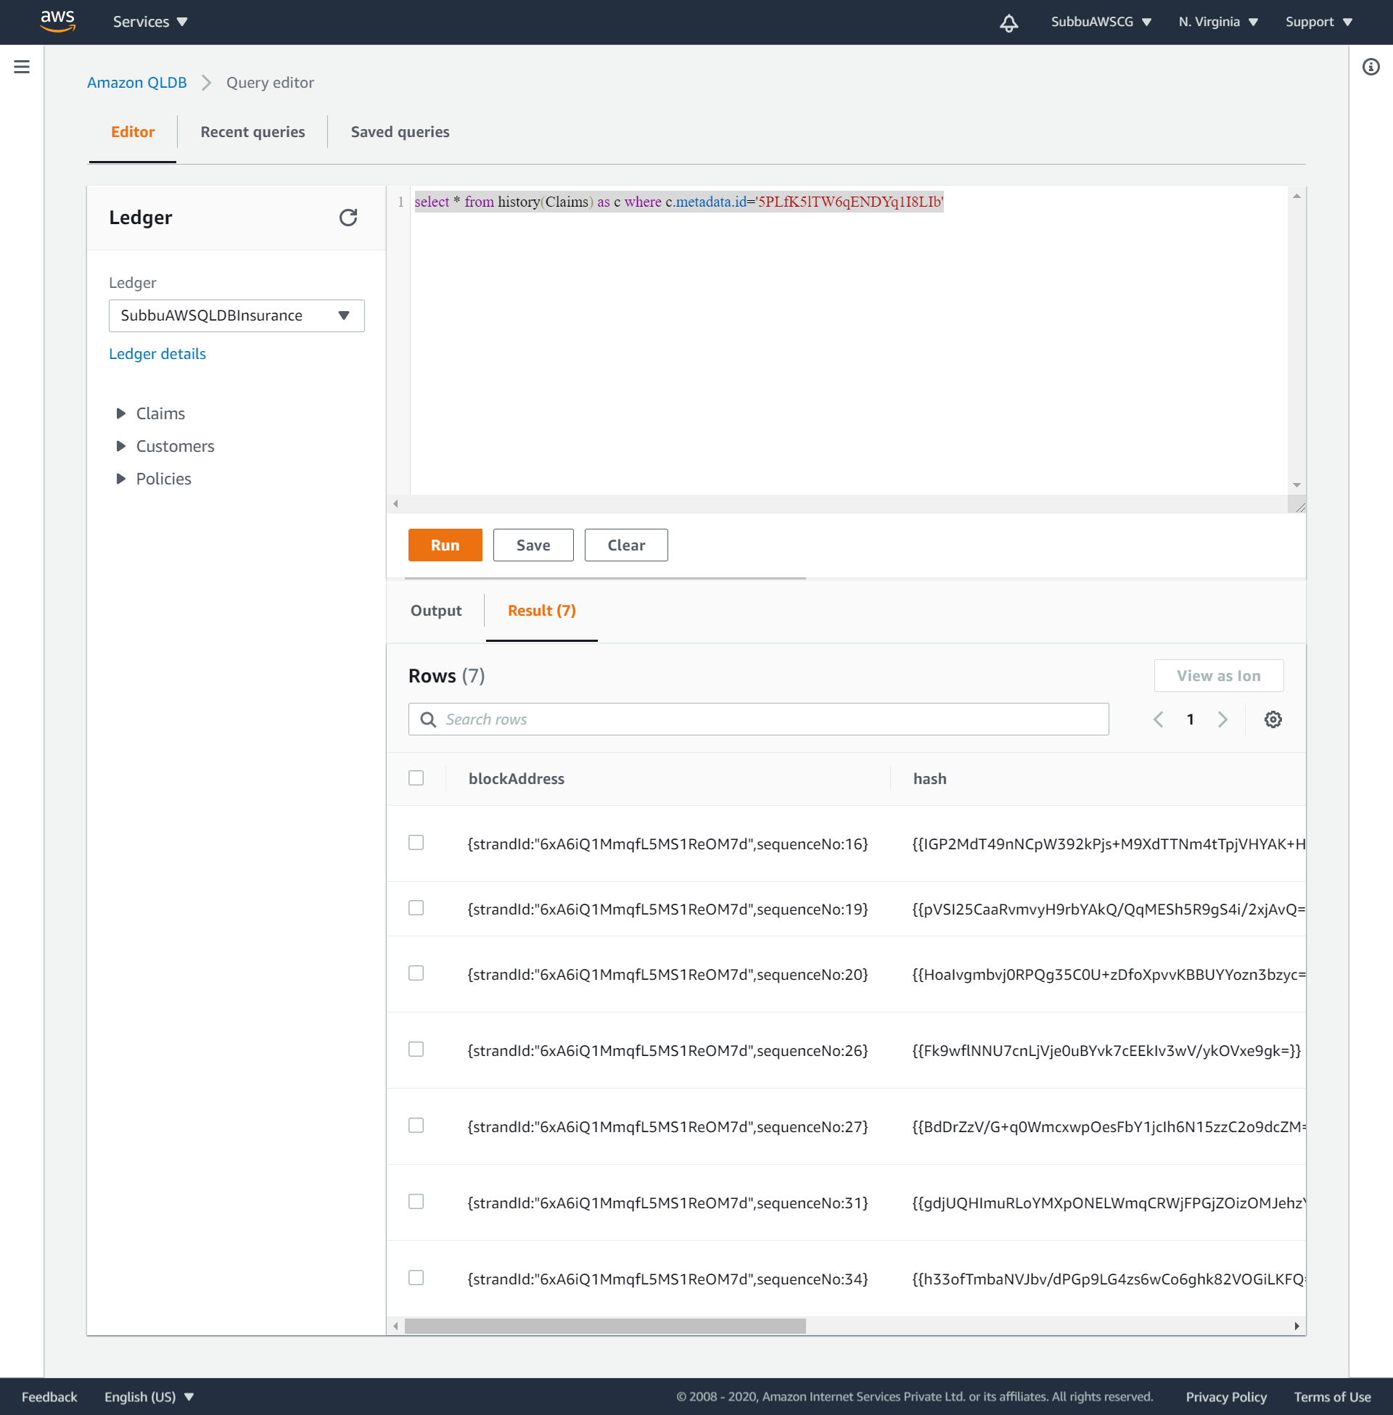
select * from history(Claims) as c where c.metadata.id='5PLfK5lTW6qENDYq1I8LIb'

Slide 59
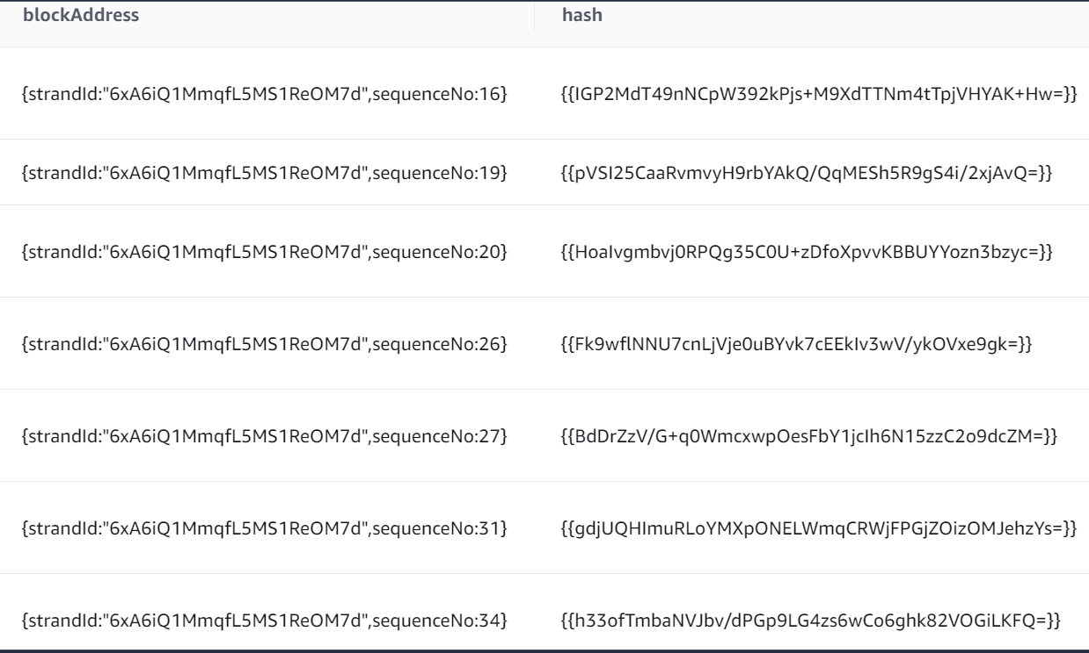
Blockaddress and hash, for a metadata ID=‘5PLfK5lTW6qENDYq1I8LIb’:

Slide 60
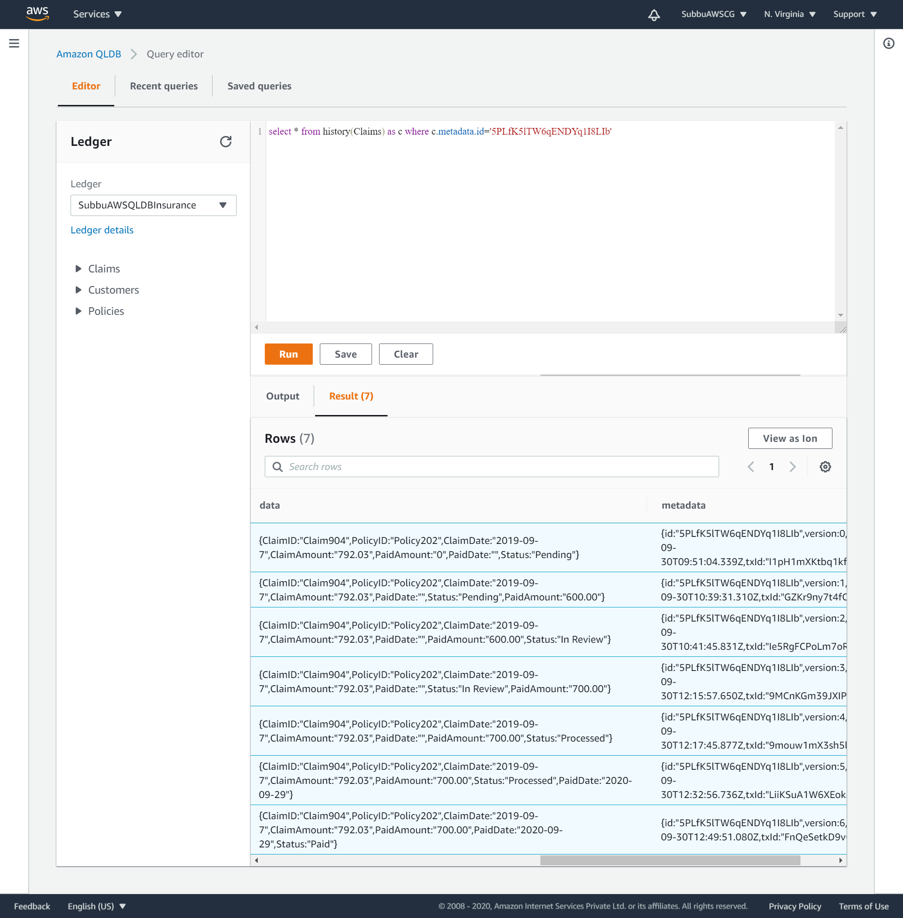
Data and metadata for a metadata ID=‘5PLfK5lTW6qENDYq1I8LIb’:

Slide 61
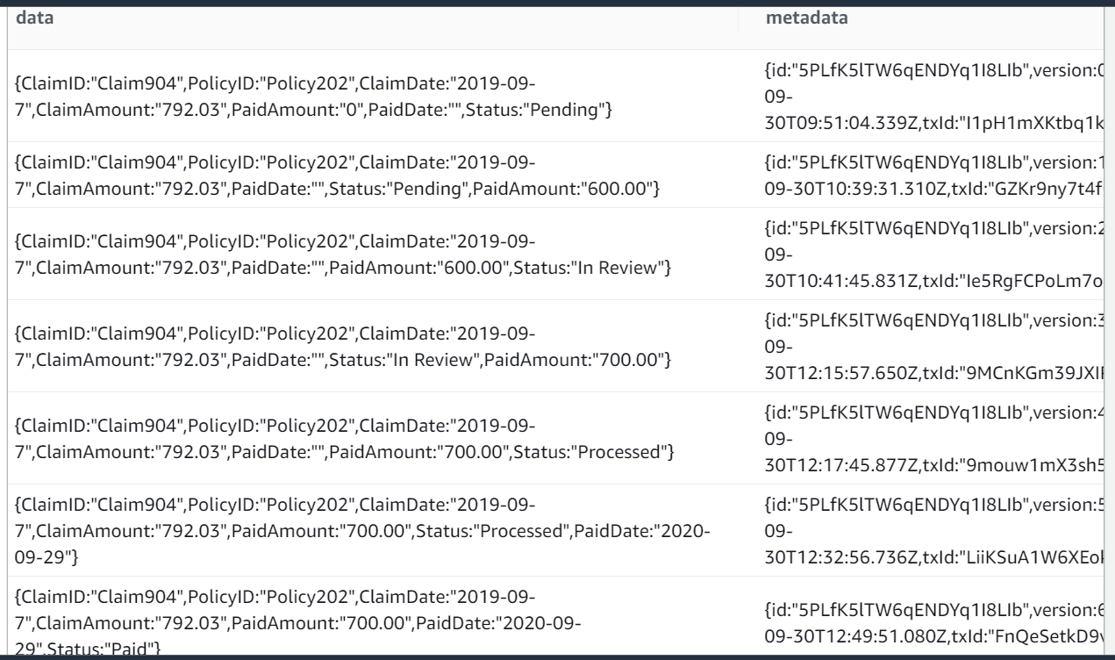
Data and metadata for a metadata ID=‘5PLfK5lTW6qENDYq1I8LIb’:

Slide 62
Revisions listed: blockAddress and Data for the metadataID= ‘5PLfK5lTW6qENDYq1I8LIb’ , whose ClaimID= ‘Claim904’. Multiple revisions on the original value, for the Claim904.
blockAddress: {strandId:"6xA6iQ1MmqfL5MS1ReOM7d",sequenceNo:16} –
Data: {ClaimID:"Claim904",PolicyID:"Policy202",ClaimDate:"2019-09-7",ClaimAmount:"792.03",PaidAmount:"0",PaidDate:"",Status:"Pending"}
Revision1 - blockAddress: {strandId:"6xA6iQ1MmqfL5MS1ReOM7d",sequenceNo:19} –
Data: {ClaimID:"Claim904",PolicyID:"Policy202",ClaimDate:"2019-09-7",ClaimAmount:"792.03",PaidDate:"",Status:"Pending",PaidAmount:"600.00"}
Revision2 - blockAddress: {strandId:"6xA6iQ1MmqfL5MS1ReOM7d",sequenceNo:20} –
Data: {ClaimID:"Claim904",PolicyID:"Policy202",ClaimDate:"2019-09-7",ClaimAmount:"792.03",PaidDate:"",PaidAmount:"600.00",Status:"In Review"}
Revision3 - blockAddress: {strandId:"6xA6iQ1MmqfL5MS1ReOM7d",sequenceNo:26} –
Data: {ClaimID:"Claim904",PolicyID:"Policy202",ClaimDate:"2019-09-7",ClaimAmount:"792.03",PaidDate:"",Status:"In Review",PaidAmount:"700.00"}
Revision4 - blockAddress: {strandId:"6xA6iQ1MmqfL5MS1ReOM7d",sequenceNo:27} –
Data: {ClaimID:"Claim904",PolicyID:"Policy202",ClaimDate:"2019-09-7",ClaimAmount:"792.03",PaidDate:"",PaidAmount:"700.00",Status:"Processed"}
Revision5 - blockAddress: {strandId:"6xA6iQ1MmqfL5MS1ReOM7d",sequenceNo:31} –
Data: {ClaimID:"Claim904",PolicyID:"Policy202",ClaimDate:"2019-09-7",ClaimAmount:"792.03",PaidAmount:"700.00",Status:"Processed",PaidDate:"2020-09-29"}
Revision6 - blockAddress: {strandId:"6xA6iQ1MmqfL5MS1ReOM7d",sequenceNo:34} –
Data: {ClaimID:"Claim904",PolicyID:"Policy202",ClaimDate:"2019-09-7",ClaimAmount:"792.03",PaidAmount:"700.00",PaidDate:"2020-09-29",Status:"Paid"}

Slide 63
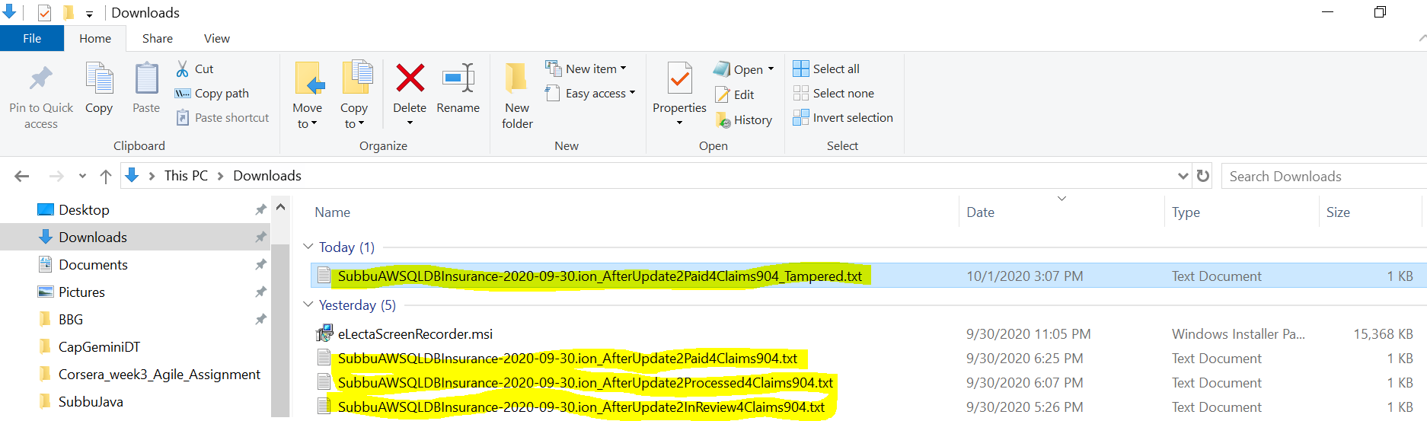
Downloaded Digests, after sets of different blocks of transactions:

Slide 64
Step-8: Verifying a Transaction - Verify the blockAddress’s of the transactions of a document in the Ledger.

Slide 65
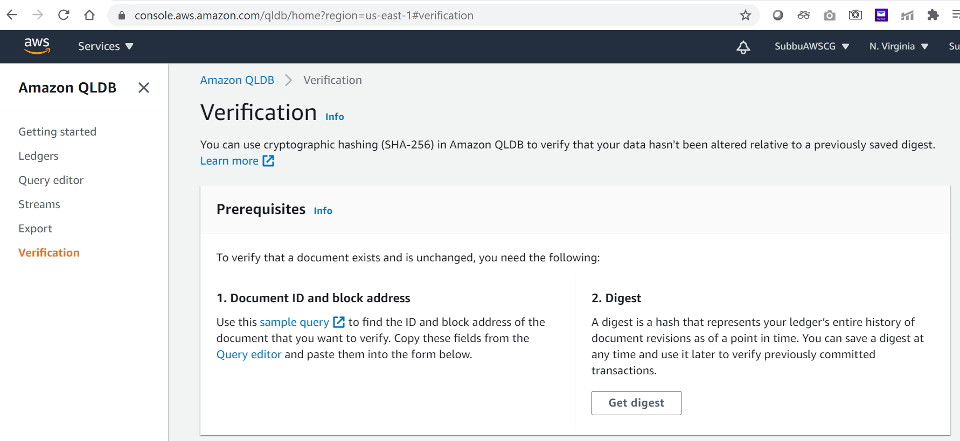
Go to QLDB Verification:

Slide 66

Choose the Ledger, DocumentID, Block address and the Digest, which we need to verify:

Slide 67

Scenario-1: Block address is less than the Sequence number of the Digest. A +ve scenario.

Slide 68

Long screenshot for more details:

Slide 69

Successfully verified:

Slide 70

Scenario-2: Block address is higher than the Sequence number of the Digest. A –ve scenario.

Slide 71

Scenario-3: Block address is less than the Sequence number of the Digest (A +ve scenario, with different BlockID and within the Sequence number of the digest).

Slide 72

Successfully verified:

Slide 73

Identified the given blockAddress as revision5 on the Claim904:

Slide 74

More details in the long screenshot:

Slide 75

Scenario-4: Tampered hash in the Digest, with correct blockAddress. A –ve scenario.

Slide 76

Chosen the latest Digest and tampered the hash and renamed the downloaded Digest file:

Slide 77

Tampered hash will get auto validated and will not allow to Verify:

Slide 78

Scenario-5: Invalid blockAddress with correct Digest. A –ve scenario.

Slide 79

Scenario-5: Block address should be lower than the Digest tip address, in a +ve scenario. This is the 6th Revision for the Claim904.

Slide 80

Successfully verified, and identifies the given blockAddress as revison6:

Slide 81
Appendix:
https://github.com/subbugh/aws-qldb
https://aws.amazon.com/qldb/
https://docs.aws.amazon.com/qldb/index.html
https://aws.amazon.com/qldb/features/
https://docs.aws.amazon.com/qldb/latest/developerguide/what-is.html
https://docs.aws.amazon.com/qldb/latest/developerguide/ql-reference.docs.html
https://docs.aws.amazon.com/qldb/latest/developerguide/getting-started.java.tutorial.html
https://partiql.org/tutorial.html
https://aws.amazon.com/qldb/features/
https://aws.amazon.com/qldb/faqs/

